Slide 1

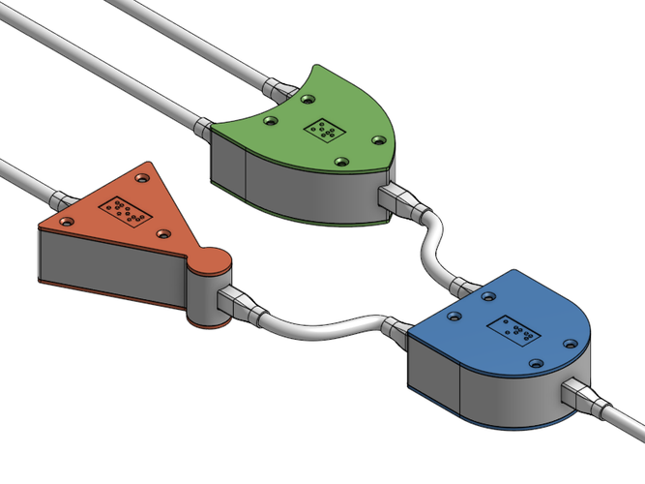
CSC 211 - Digital Logic Design 211 عال - تصميم المنطق الرقمي First Term - 1439/1440 Lecture #9
Dr. Hazem Ibrahim Shehata
Assistant Professor
College of Computing and Information Technology

Slide 2
Administrivia
Assignment #2:
To be released on Sunday.
Website: http://hshehata.github.io/courses/su/cs211

Slide 3

Chapter 5: Combinational Logic Analysis

Slide 4
Types of Digital Logic Circuits
There are two types of Digital Logic Circuits:
Combinational Logic Circuits:
Output is a pure function in the present inputs only!
Examples: adders, subtractors, encoder, decoders, multiplexers, … etc.
Sequential Logic Circuits:
Output depends not only on the present input but also on the history of the input!!
Examples: flip-flops, latches, registers, counters, memory, … etc.

Slide 5
Implementing Combinational Logic
Methods for implementing Combinational Logic:
AND-OR Logic
Usage: implementing SOP and POS expressions
NAND Logic
Usage: implementing SOP expressions
NOR Logic
Usage: implementing POS expressions
…

Slide 6
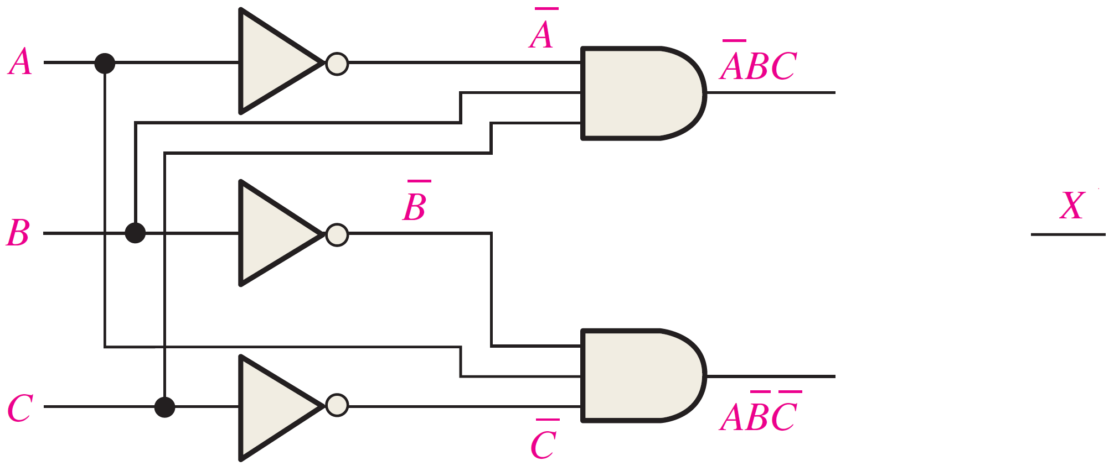
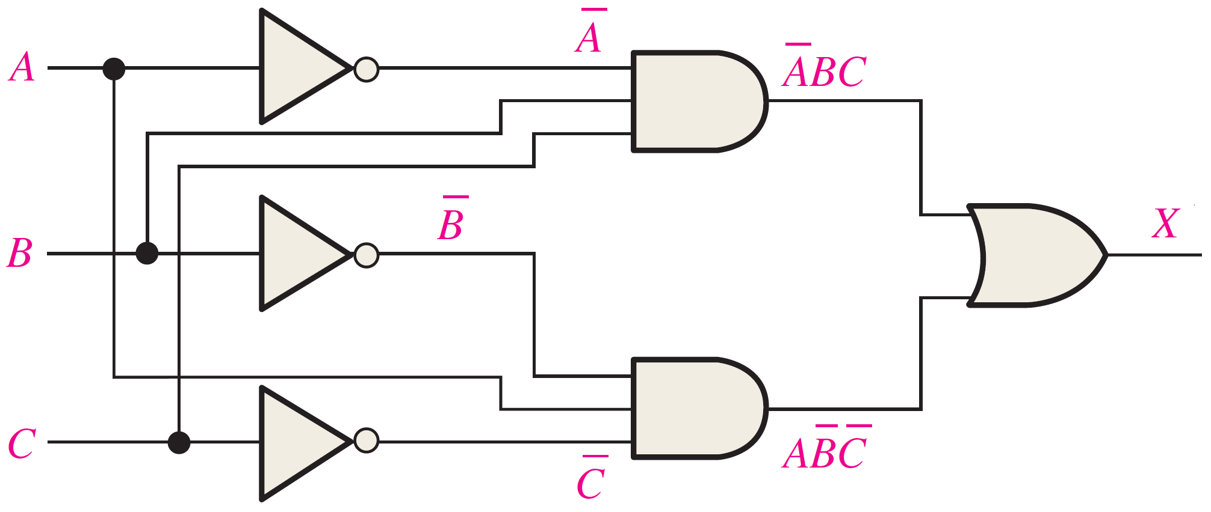
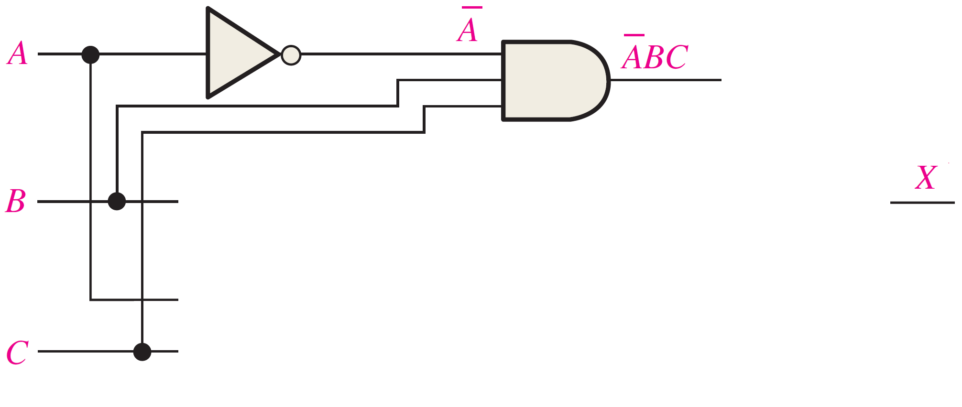
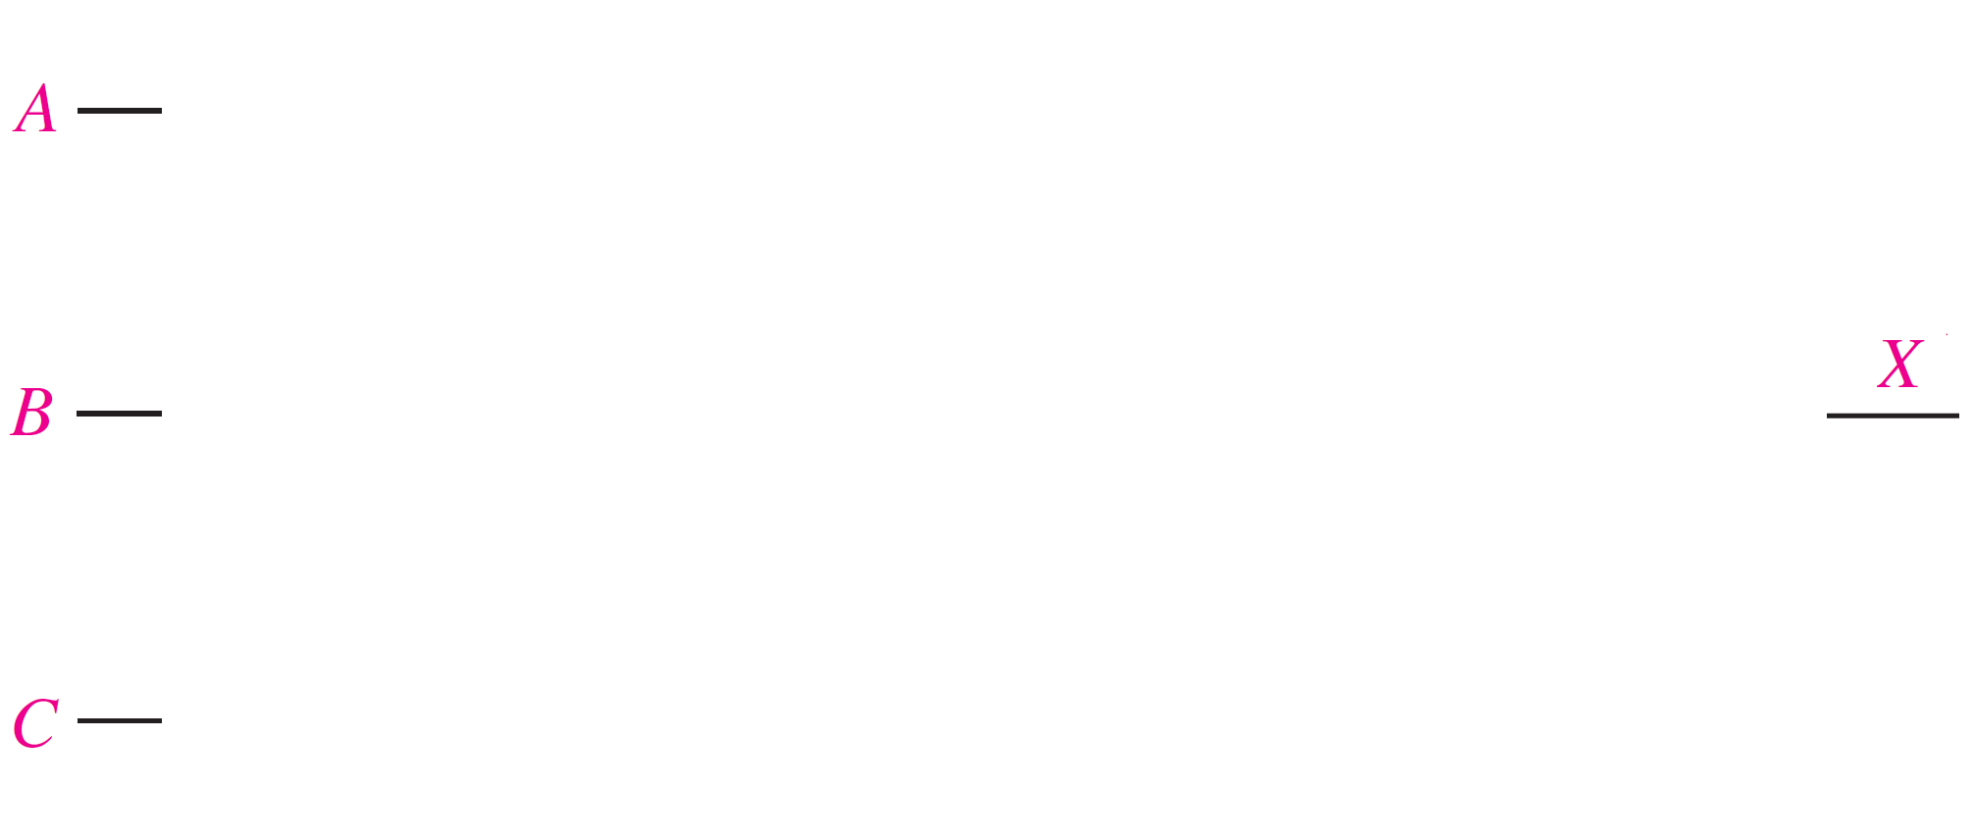
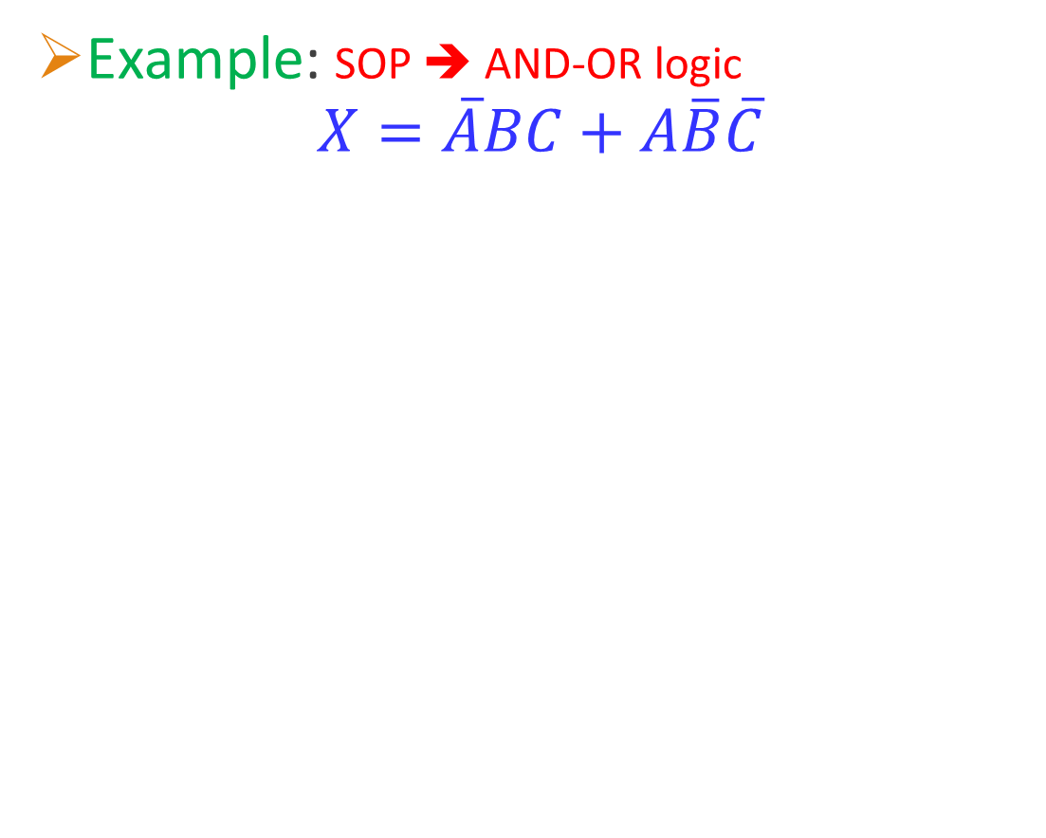
Implementing SOP expressions using AND-OR Logic
Example: SOP ➔ AND-OR logic
$$X=\overline{A}BC+A\overline{B}\overline{C}$$
Each product term is implemented by an AND gate whose inputs are the literals of the product term.
All the outputs of the AND gates are fed to an OR gate.

Slide 7
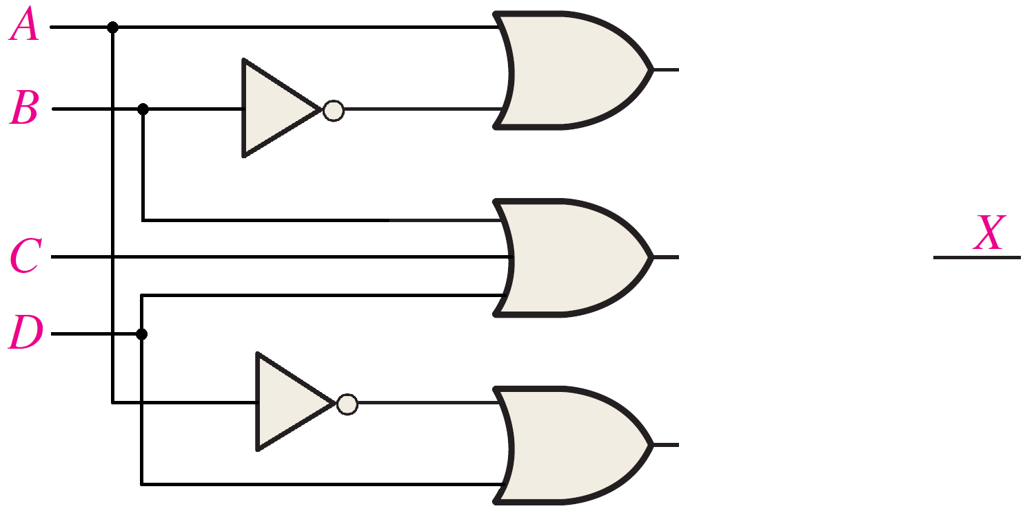
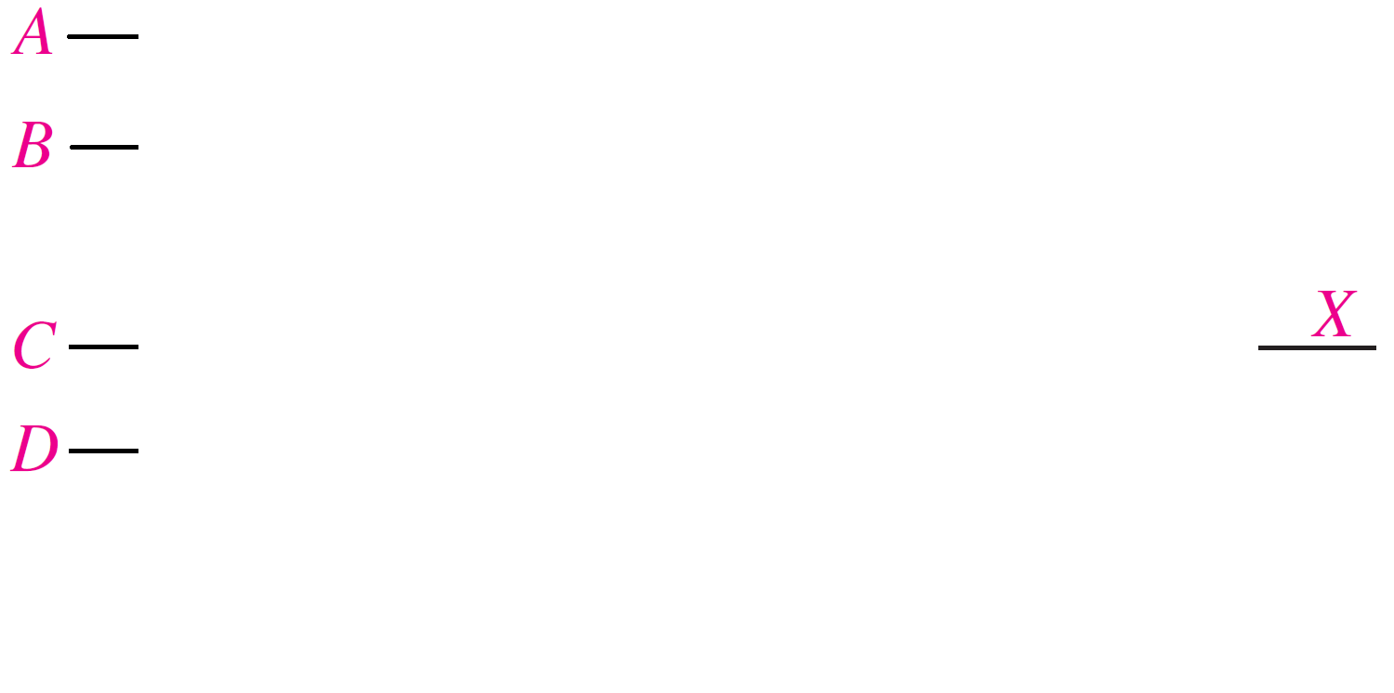
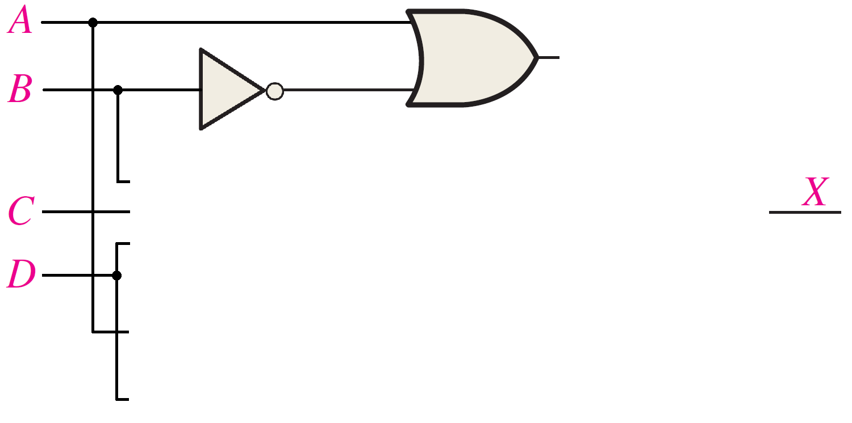
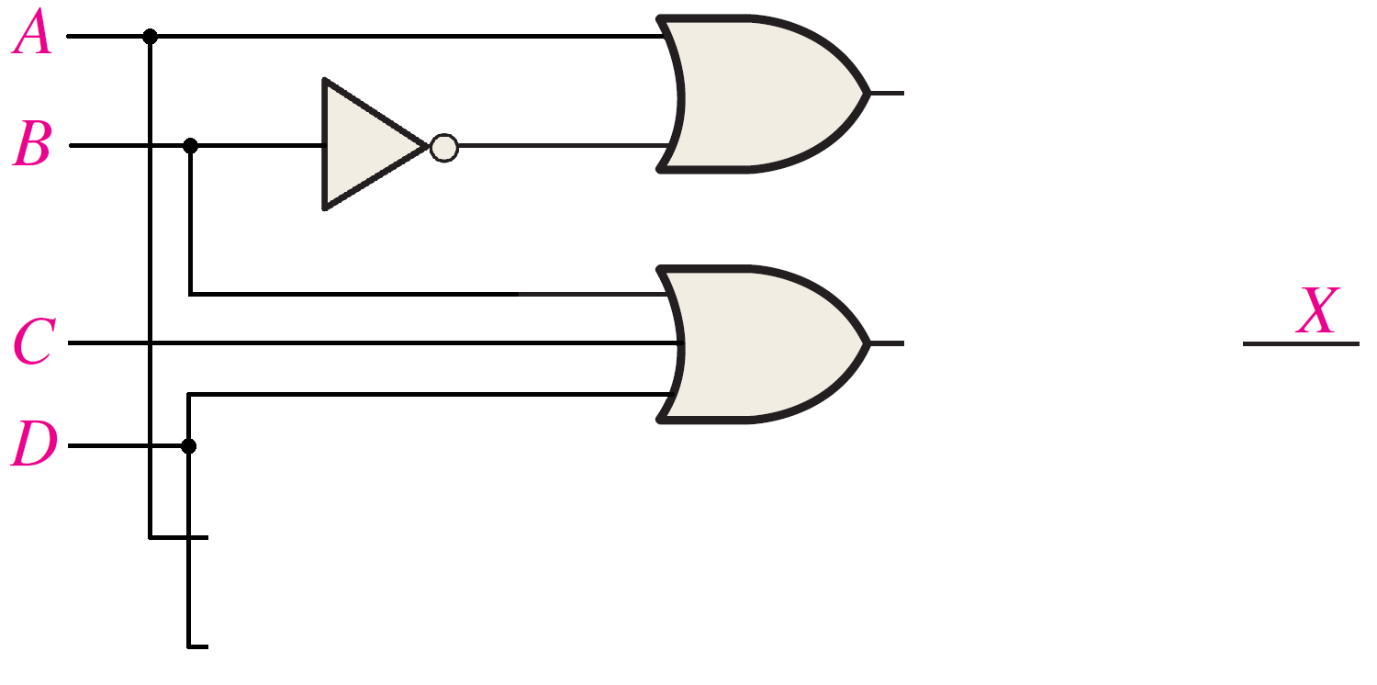
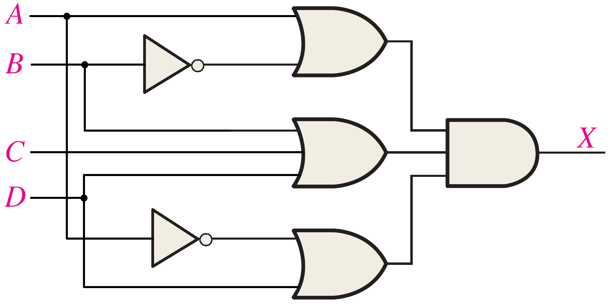


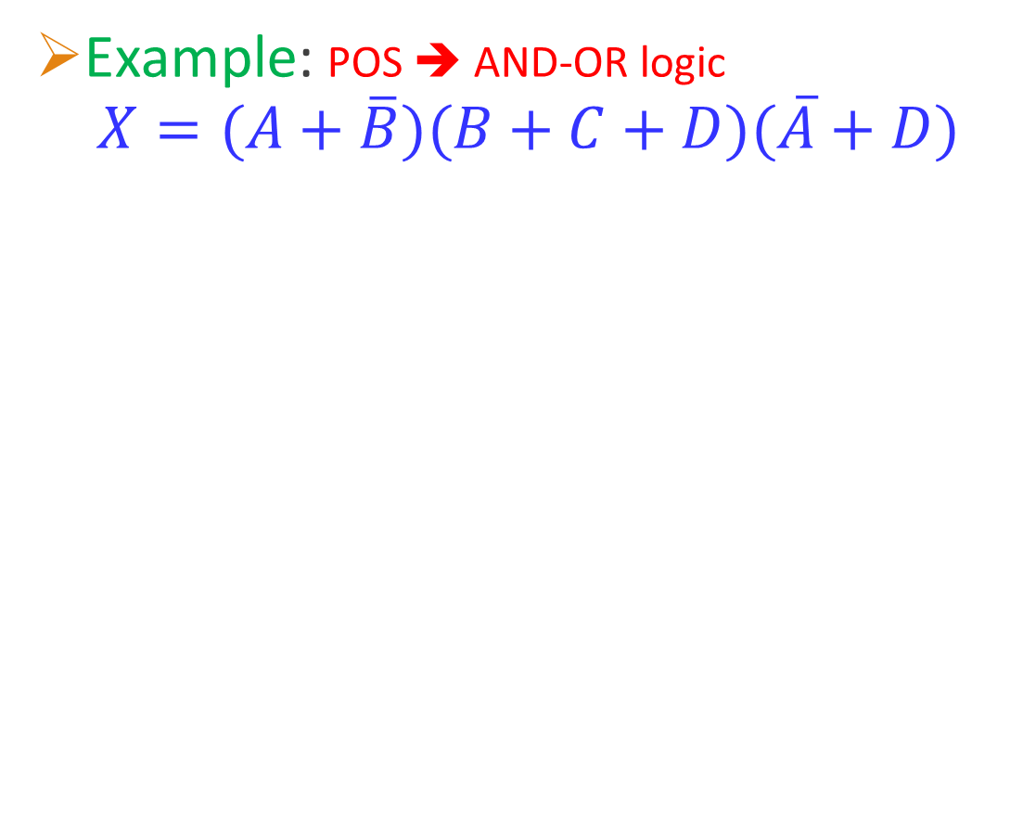



Implementing POS expressions using AND-OR Logic
Example: POS ➔ AND-OR logic
$$X=(A+\overline{B})(B+C+D)(\overline{A}+D)$$
$$A+\overline{B}$$
Each sum term is implemented by an OR gate whose inputs are the literals of the product term.
All the outputs of the OR gates are fed to an AND gate.
$$\overline{B}$$
$$B+C+D$$
$$\overline{A}$$
$$\overline{A}+D$$

Slide 8
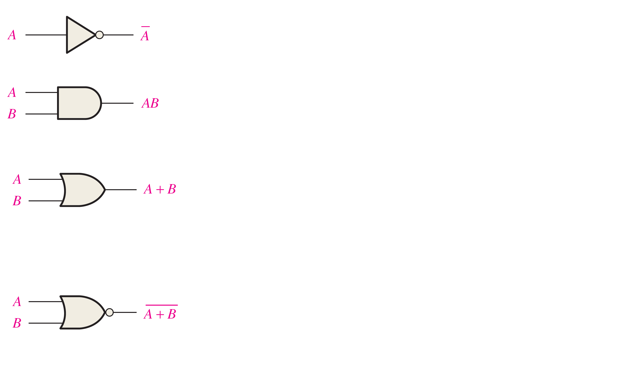
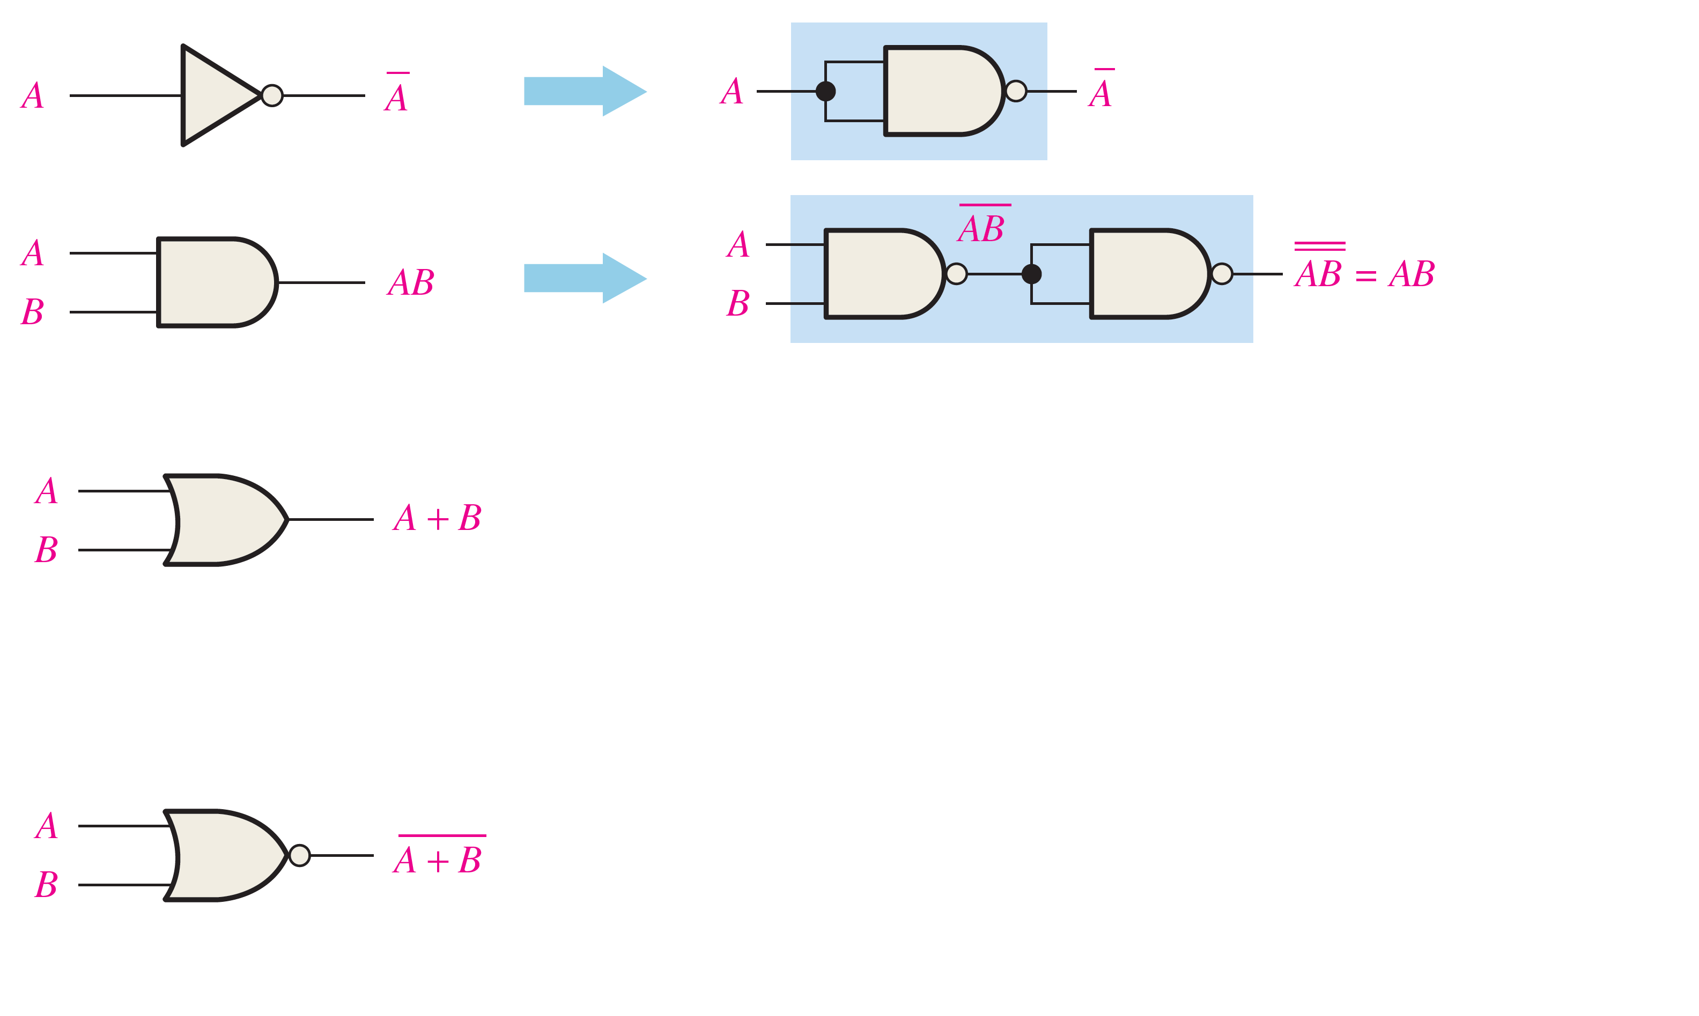
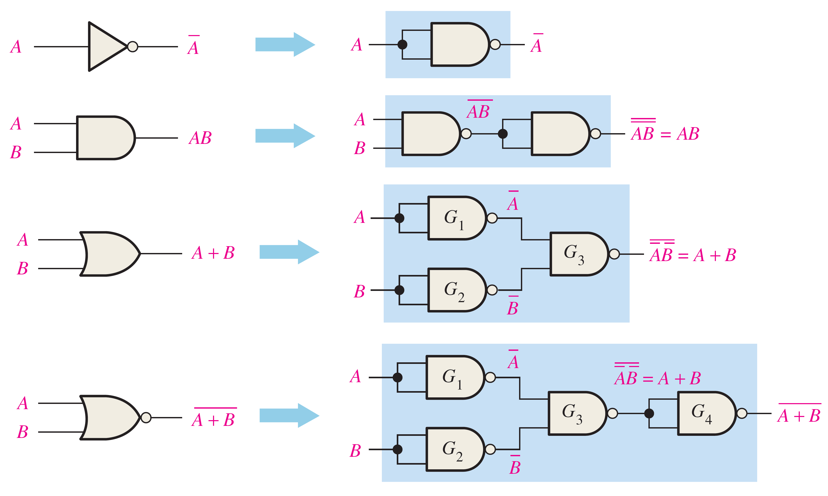
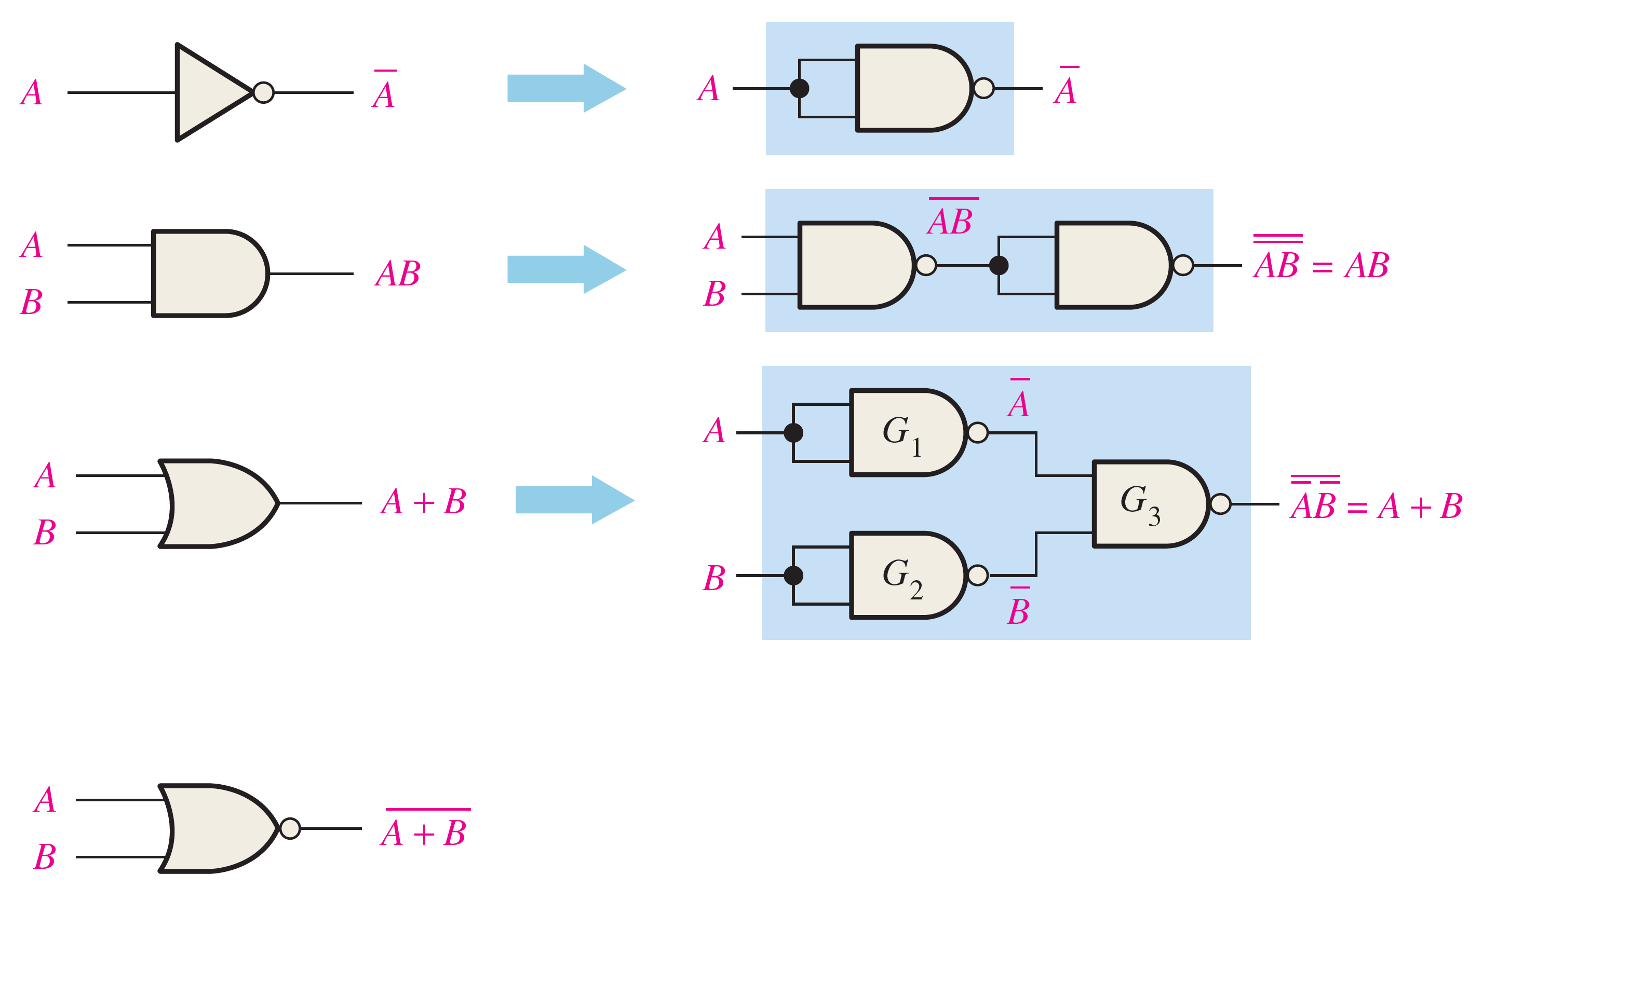
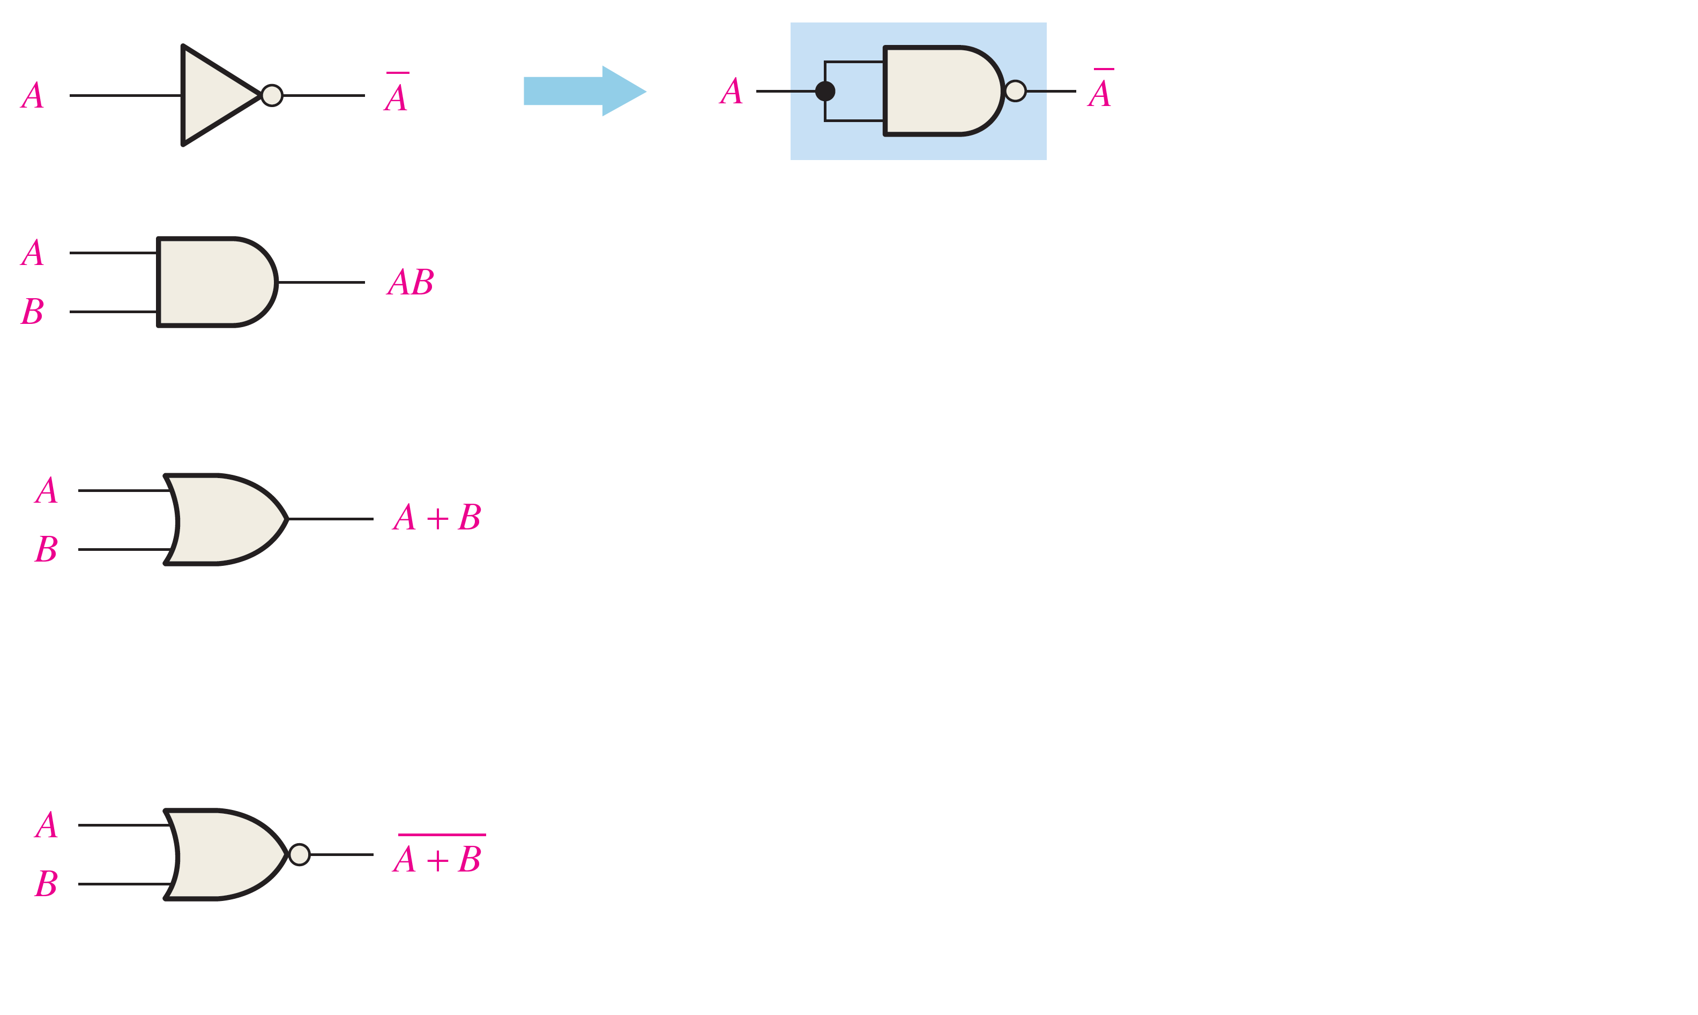
Universality of NAND gate
NAND gates can be used to implement all other gates: NOT, AND, OR, NOR!!
Hence, NAND gates can be used to implement any combinational circuit!!!

Slide 9
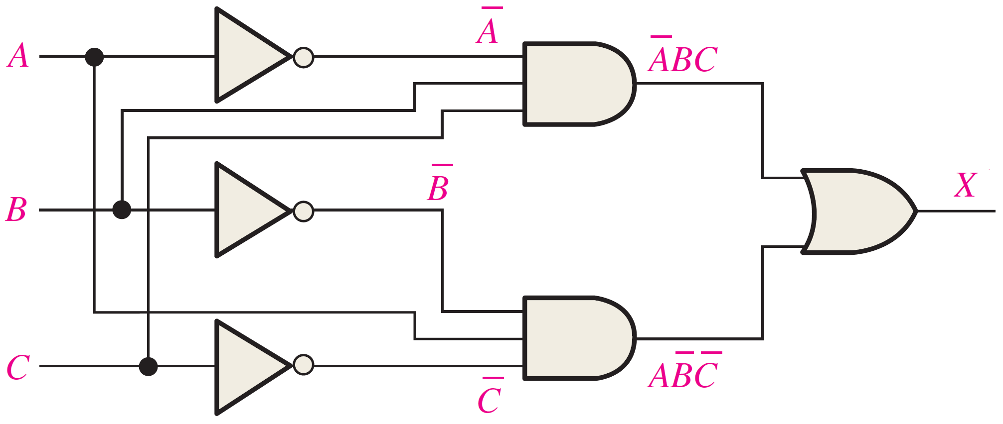
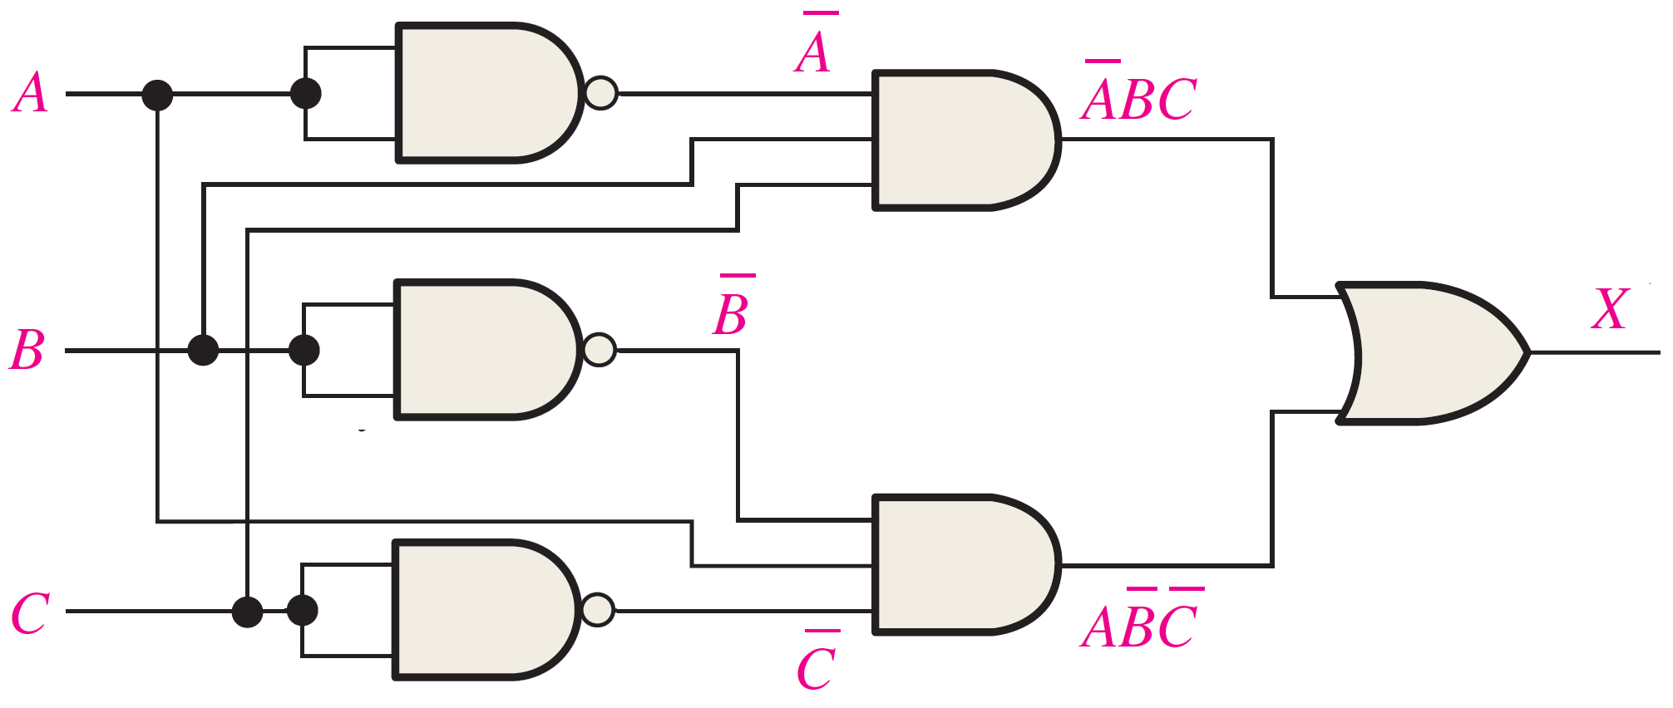
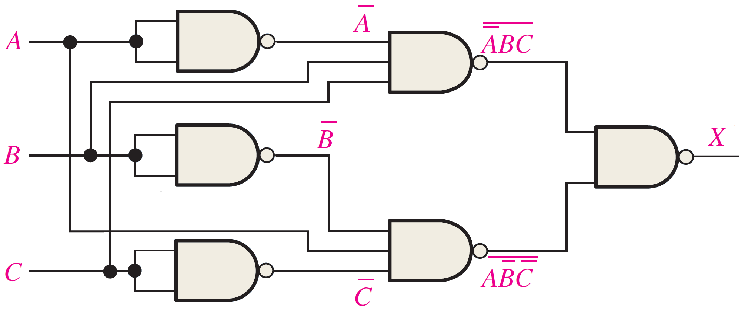
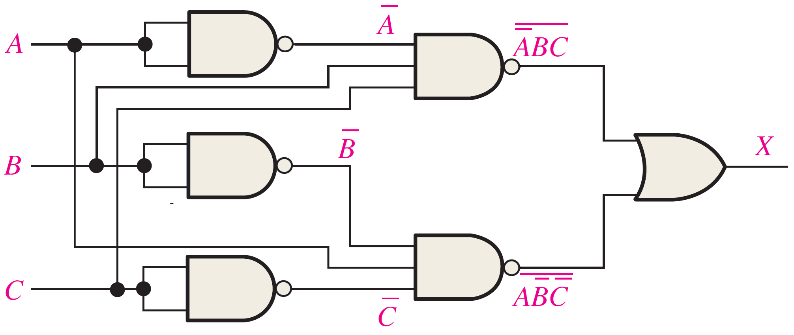
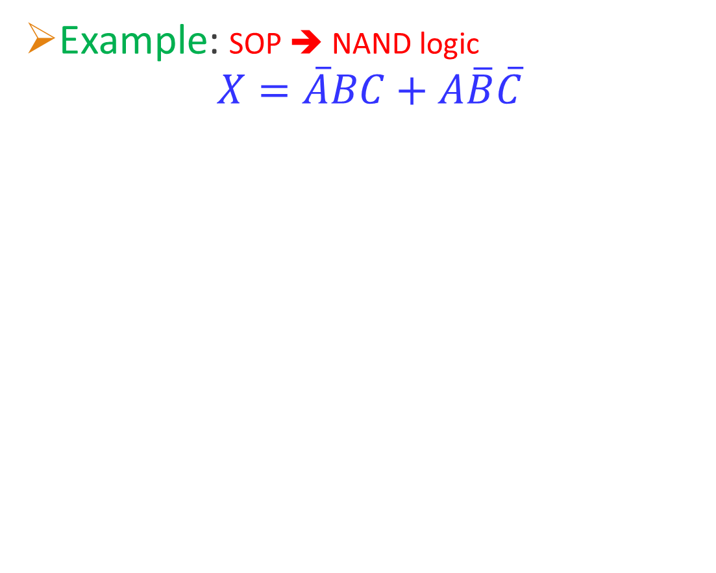
Implementing SOP expressions using NAND Logic
Example: SOP ➔ NAND logic
$$X=\overline{A}BC+A\overline{B}\overline{C}$$
Start from the AND-OR implementation (like slide #7) and then replace each:
Inverter ➔ NAND gate (Connected inputs).
AND ➔ NAND
OR ➔ NAND

Slide 10
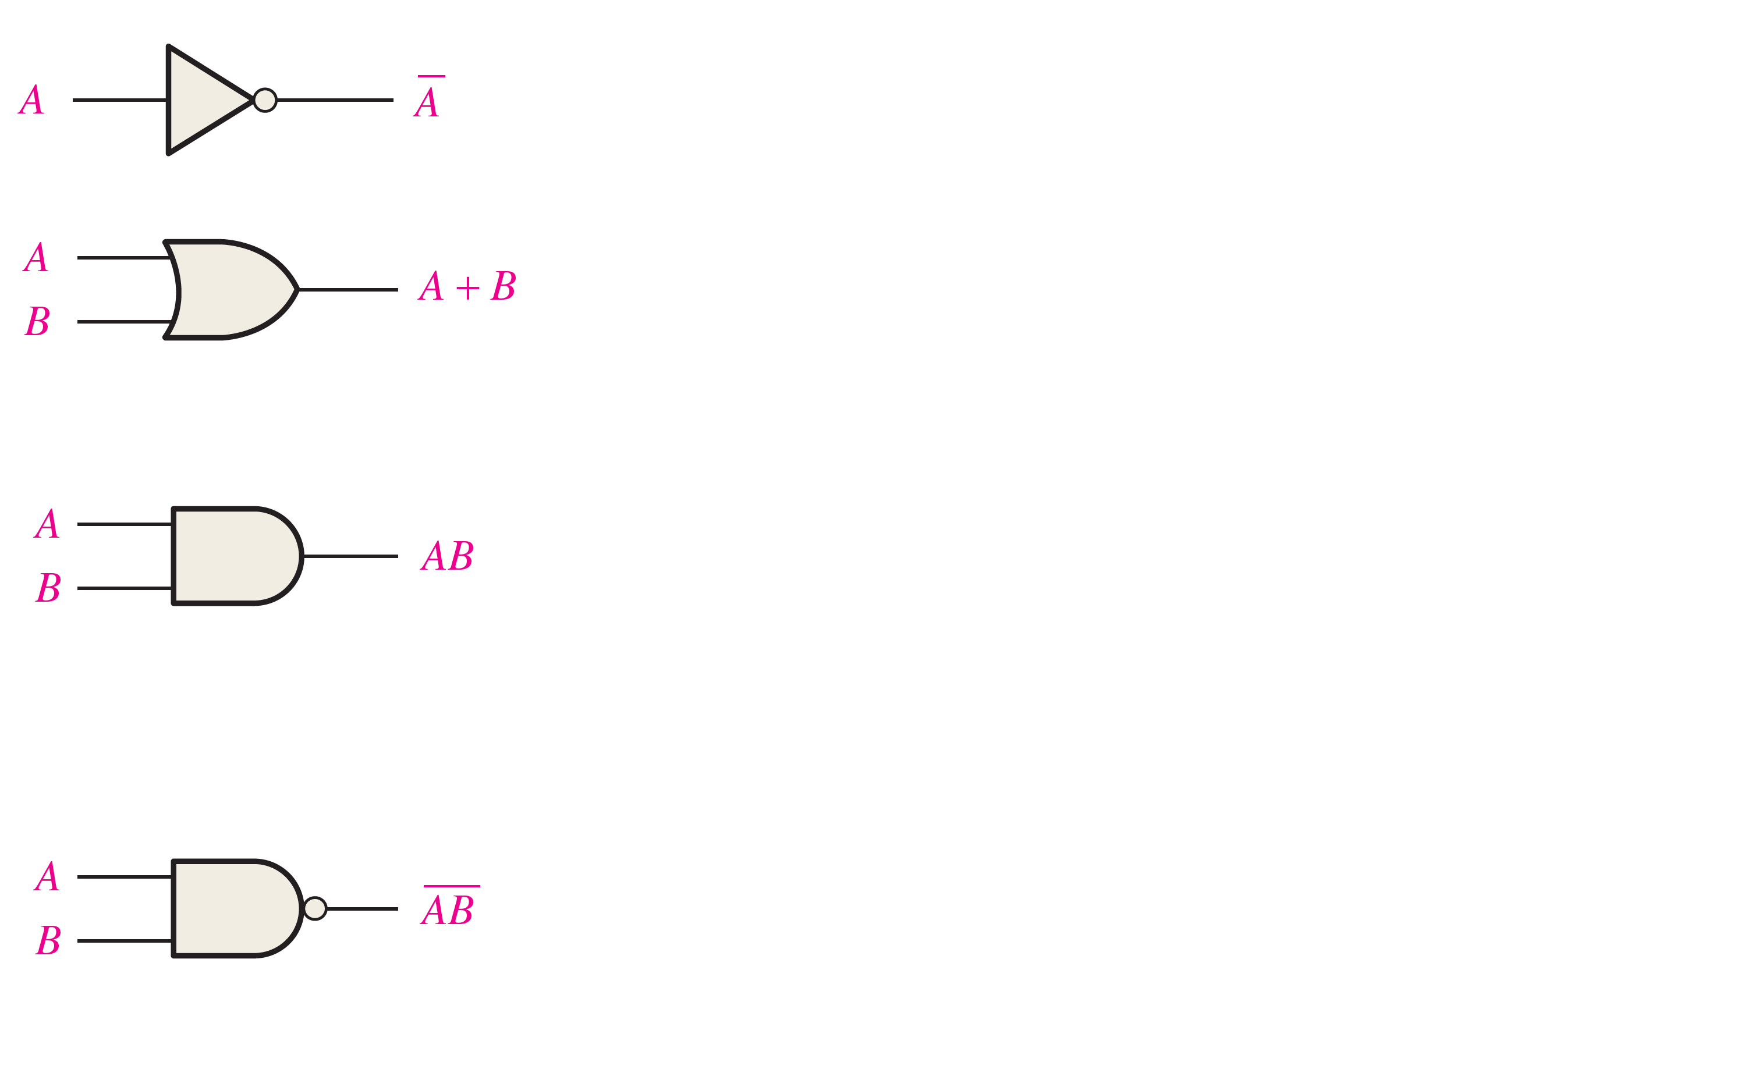
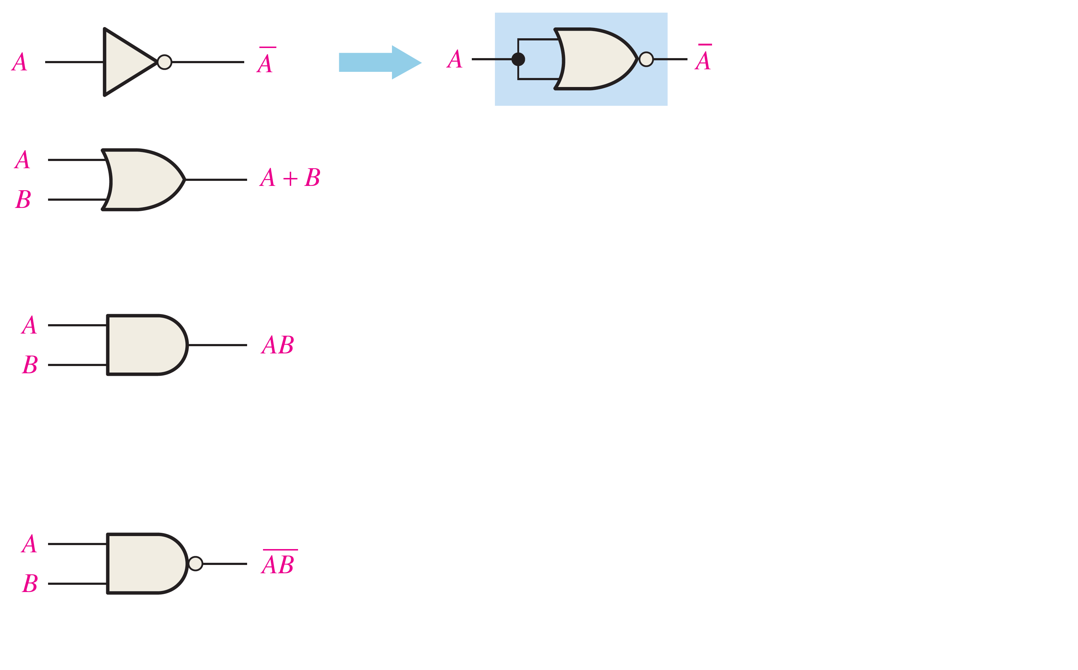
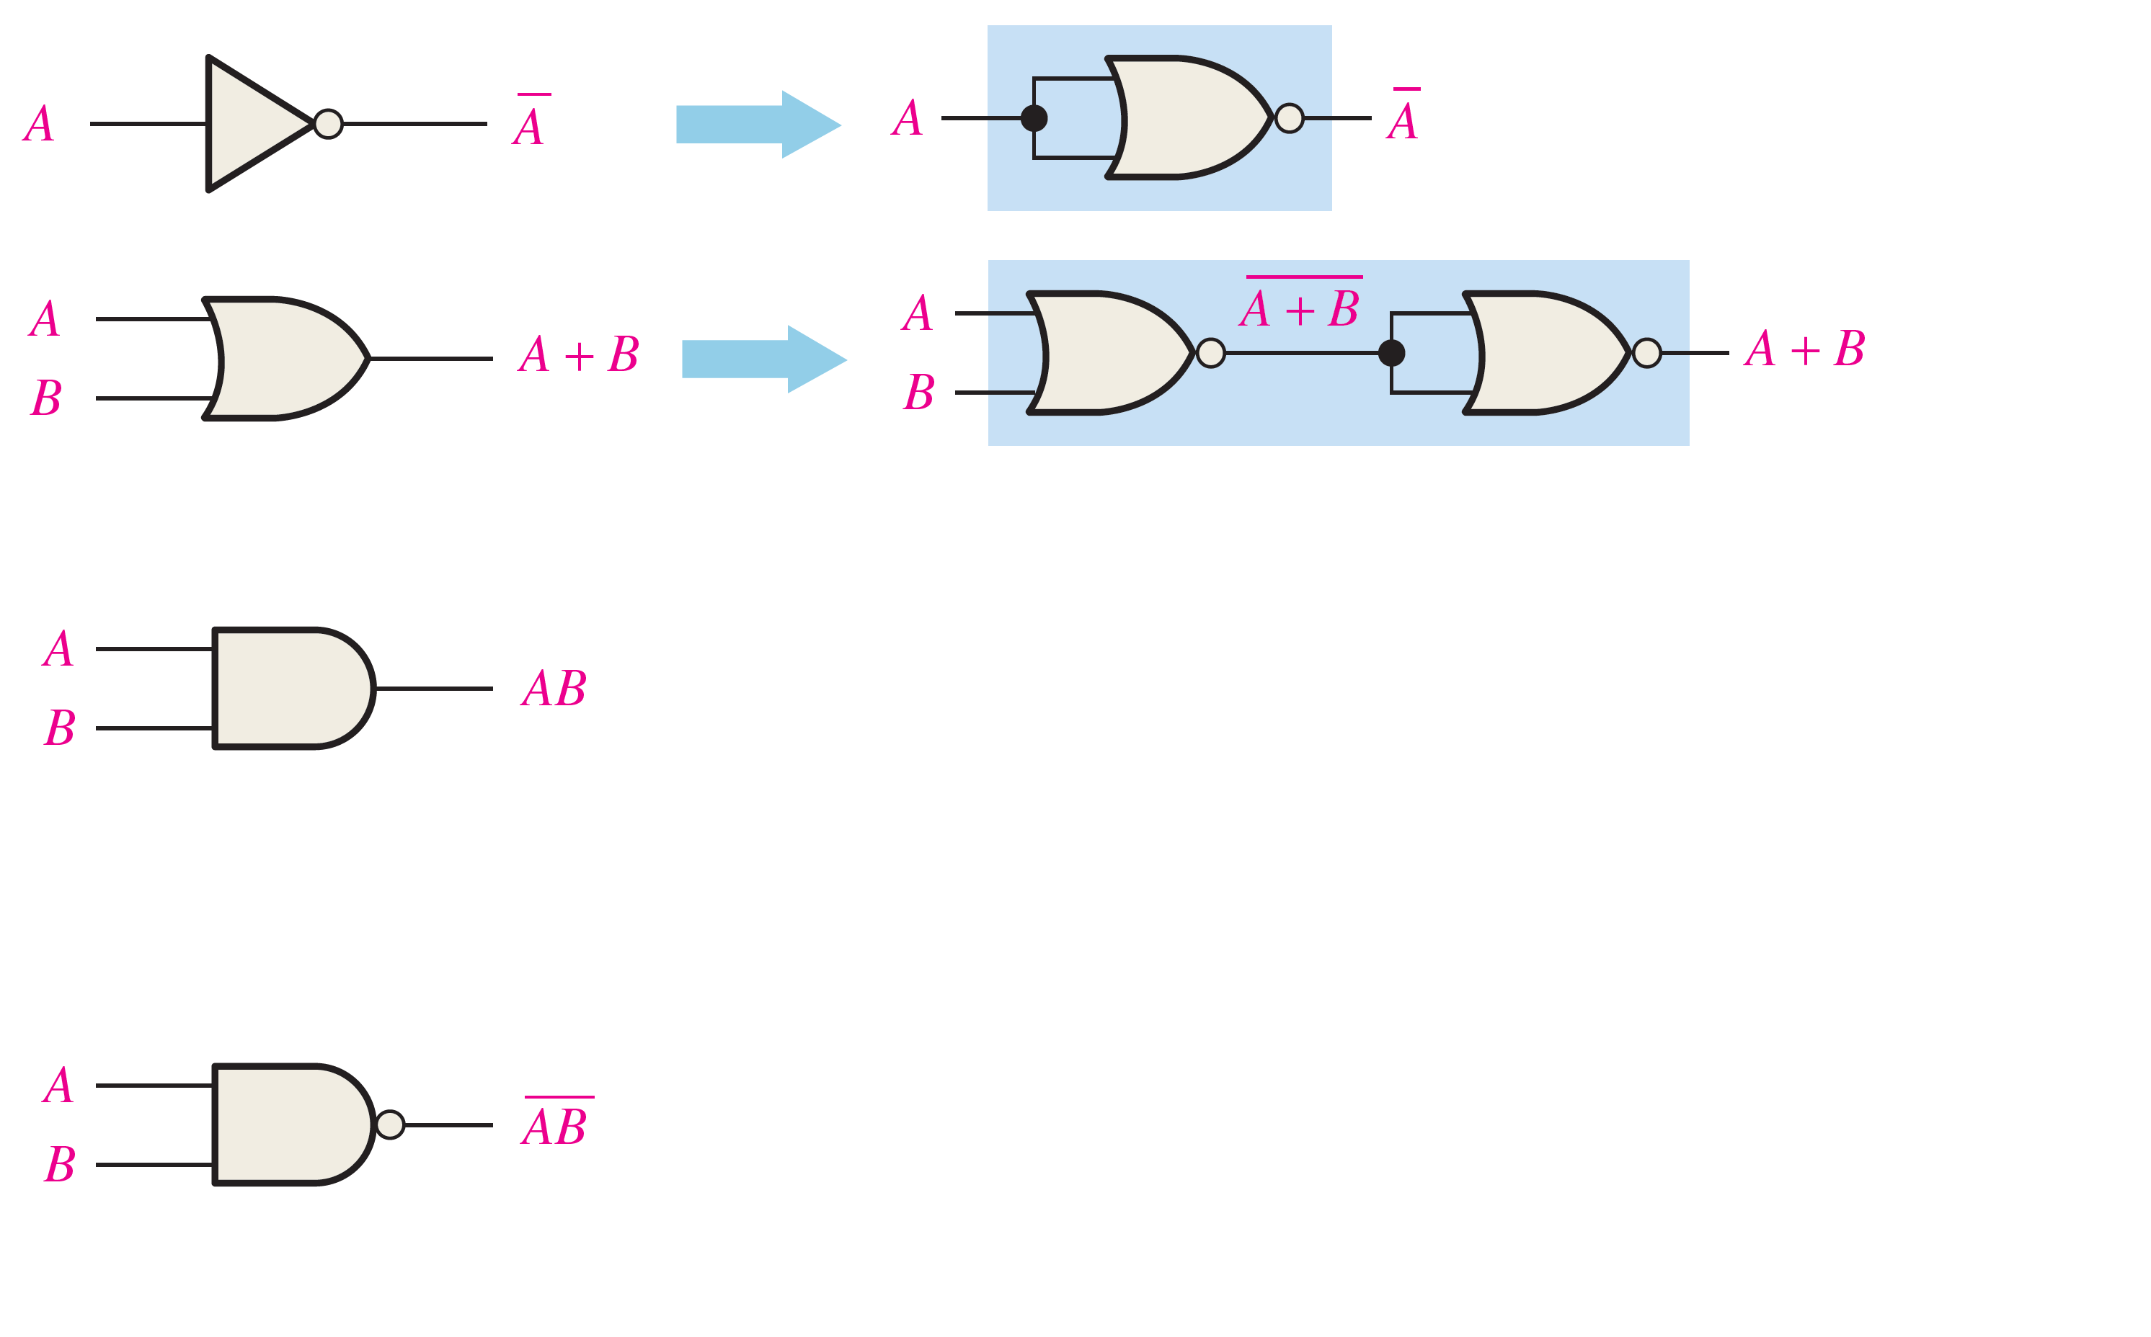
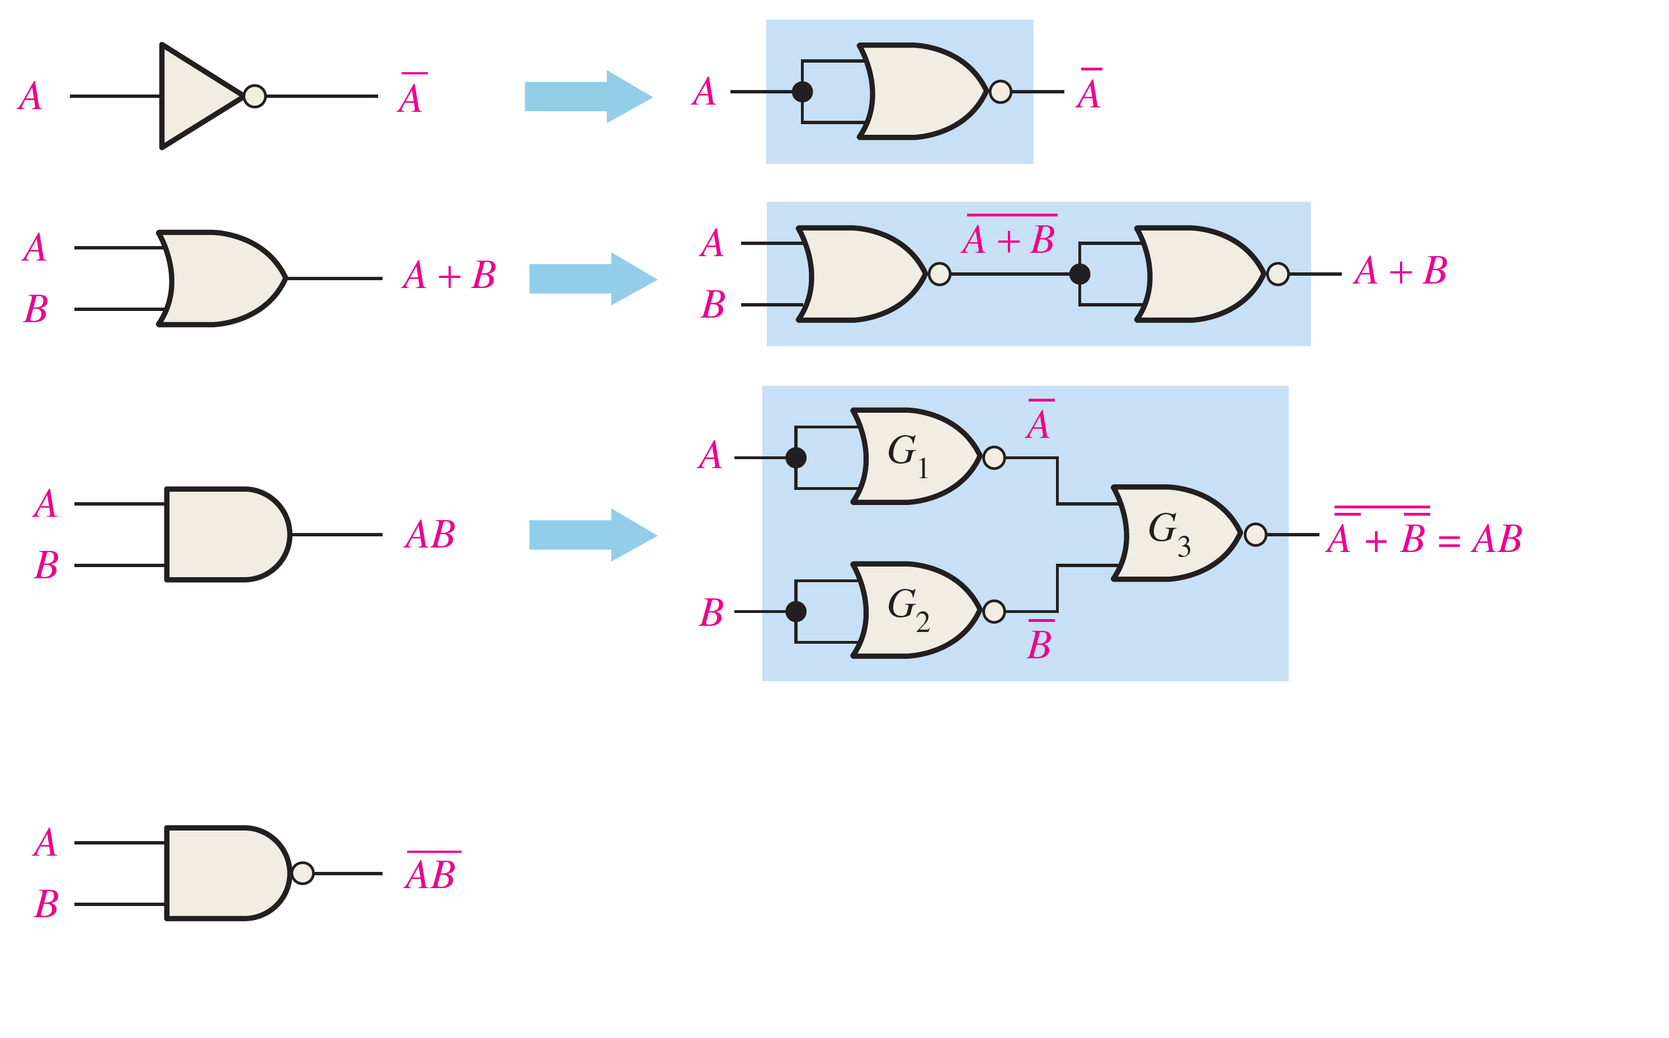
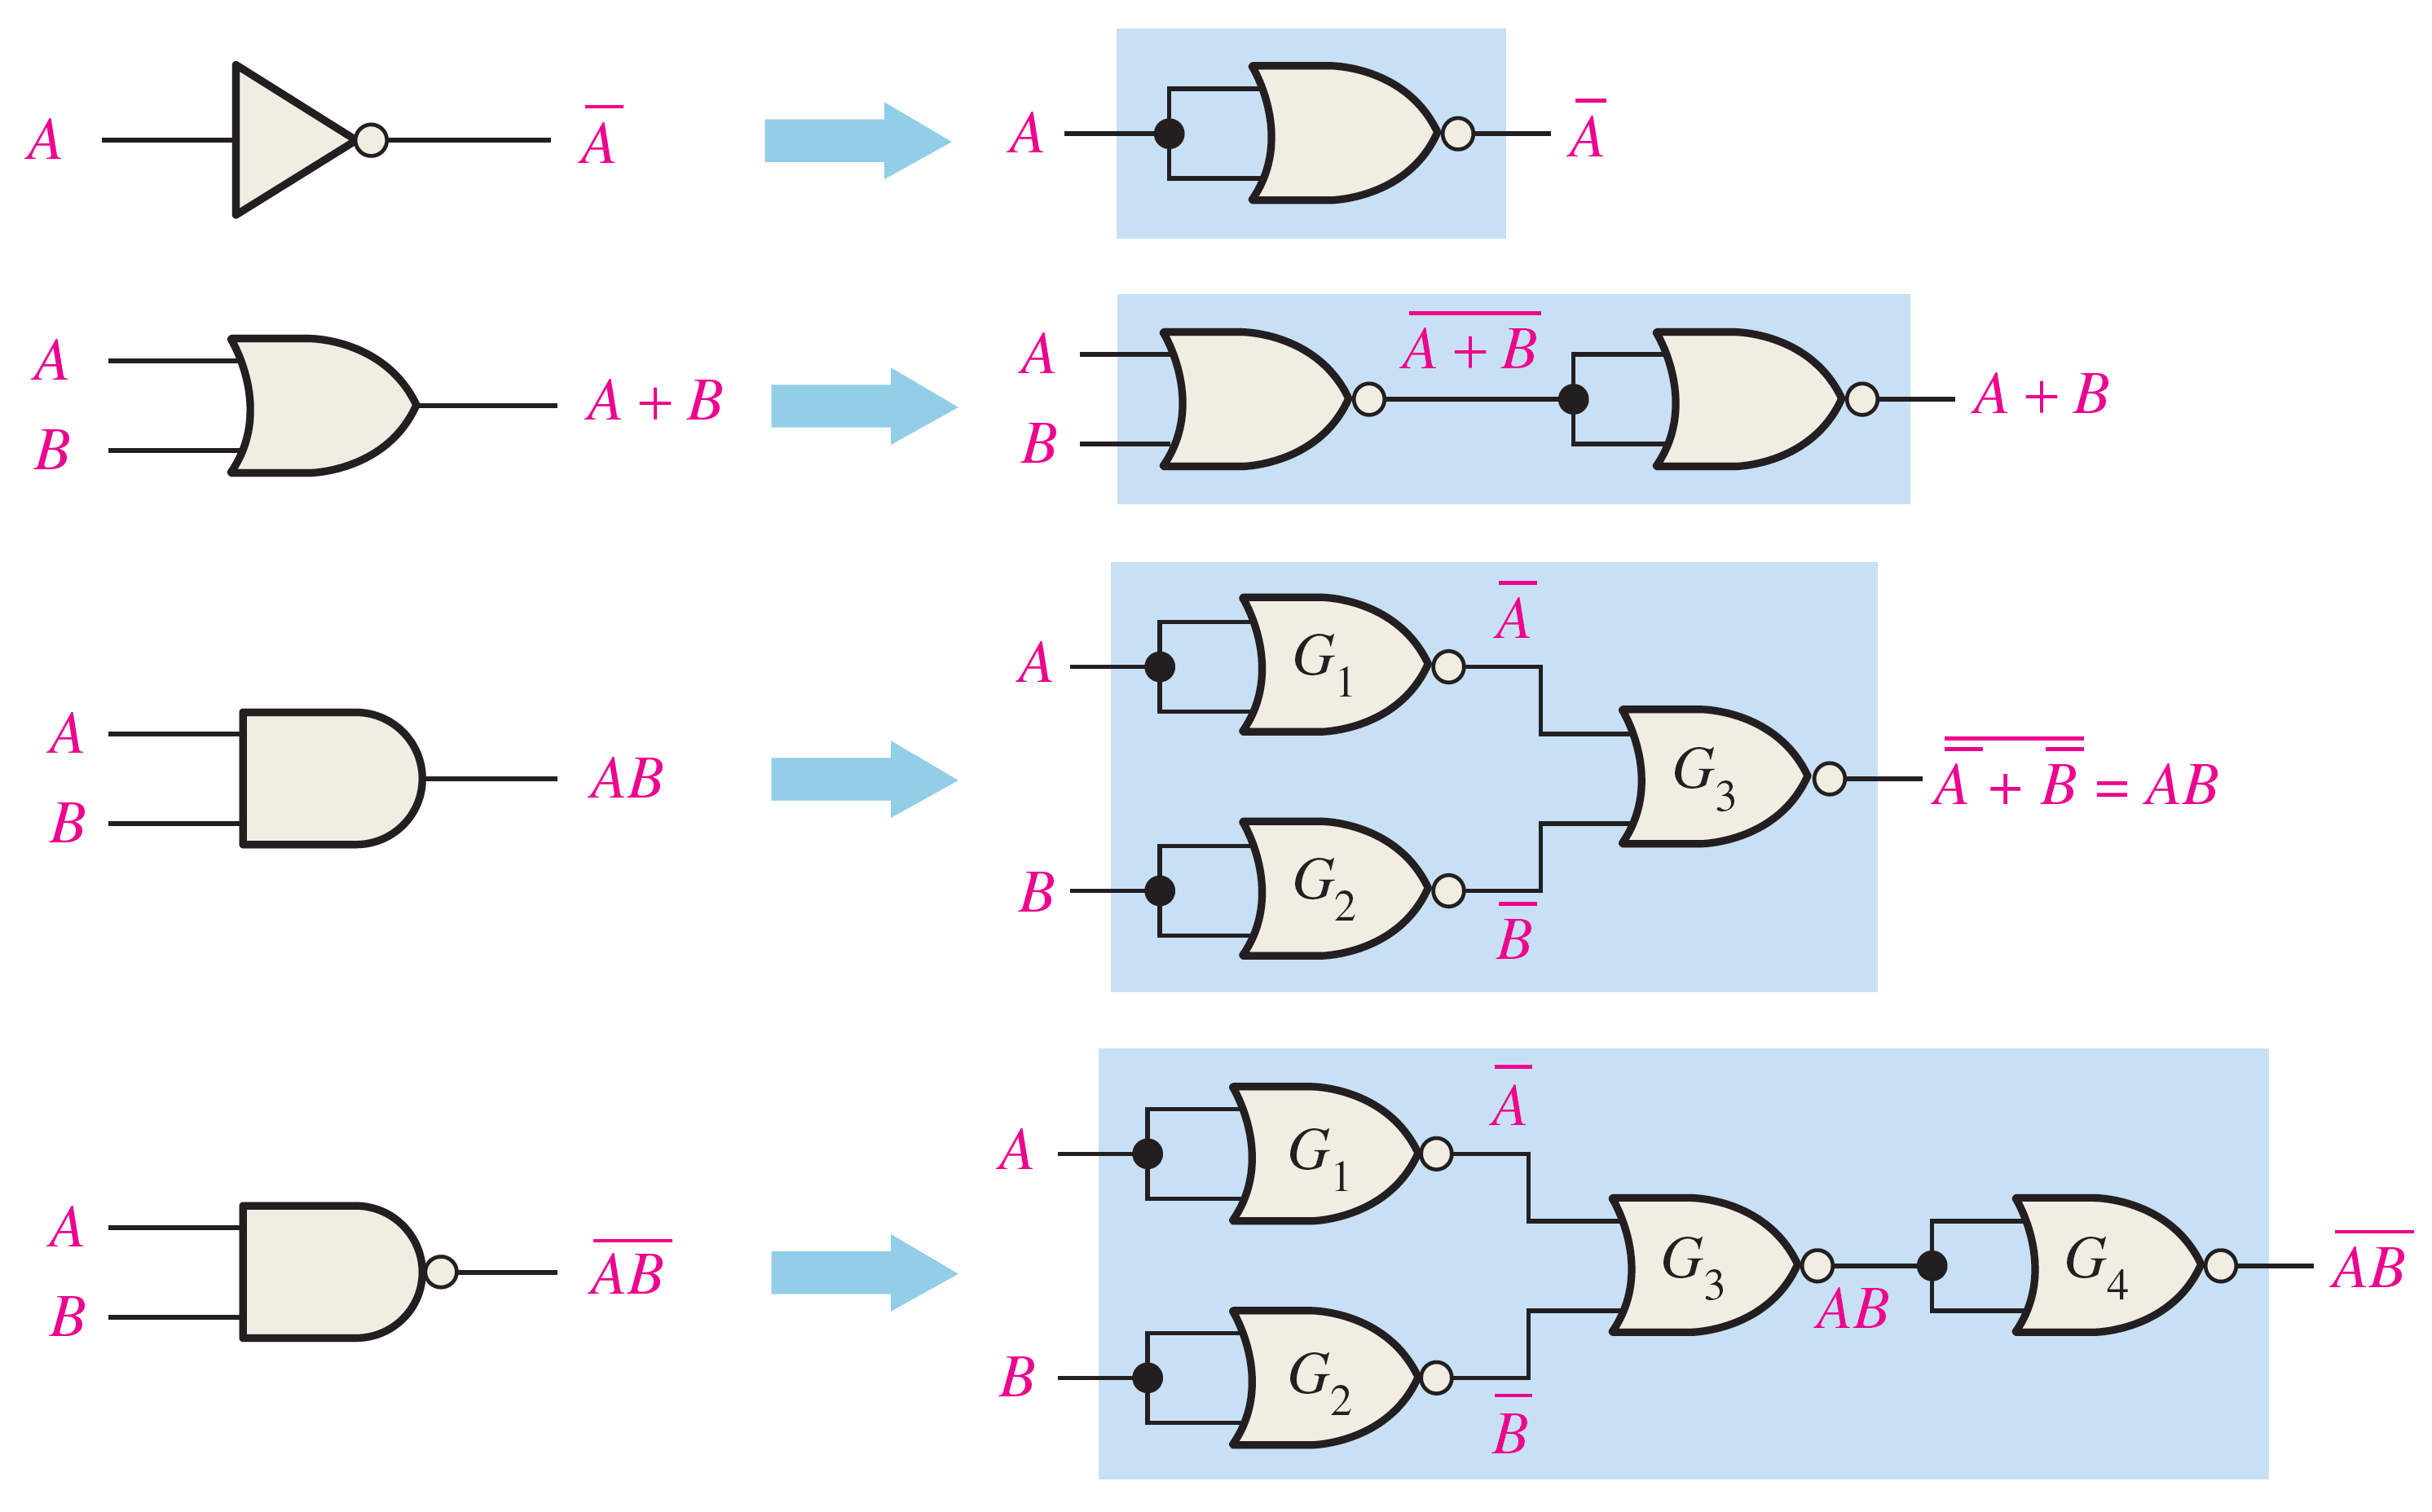
Universality of NOR gate
NOR gates can be used to implement all other gates: NOT, AND, OR, NAND!!
Hence, NOR gates can be used to implement any combinational circuit!!!

Slide 11
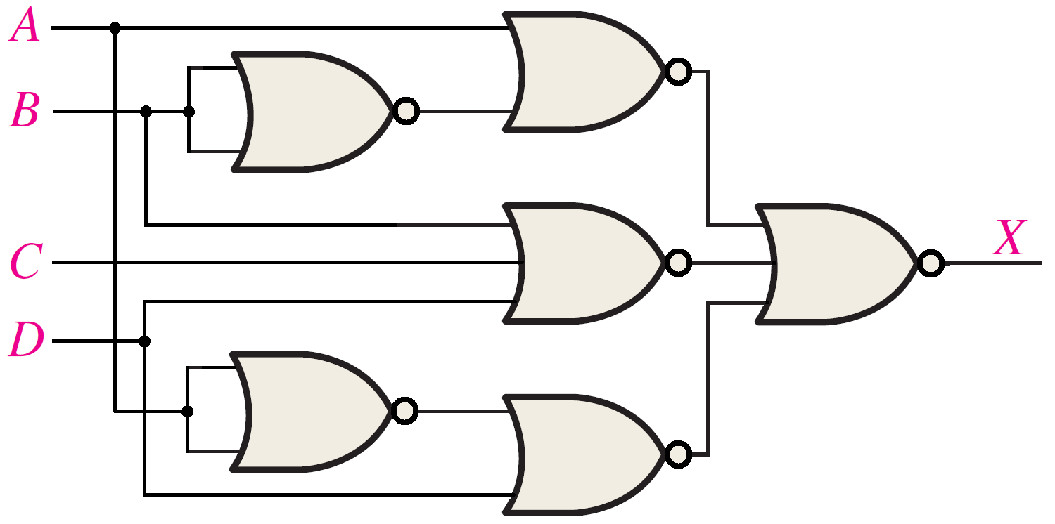
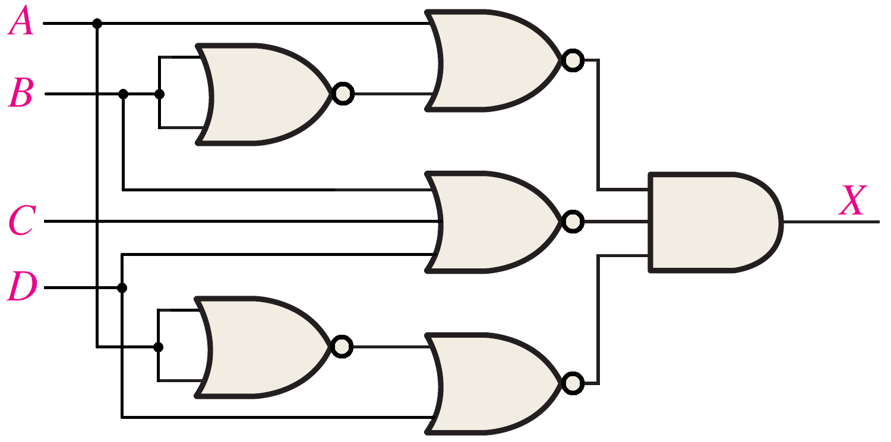
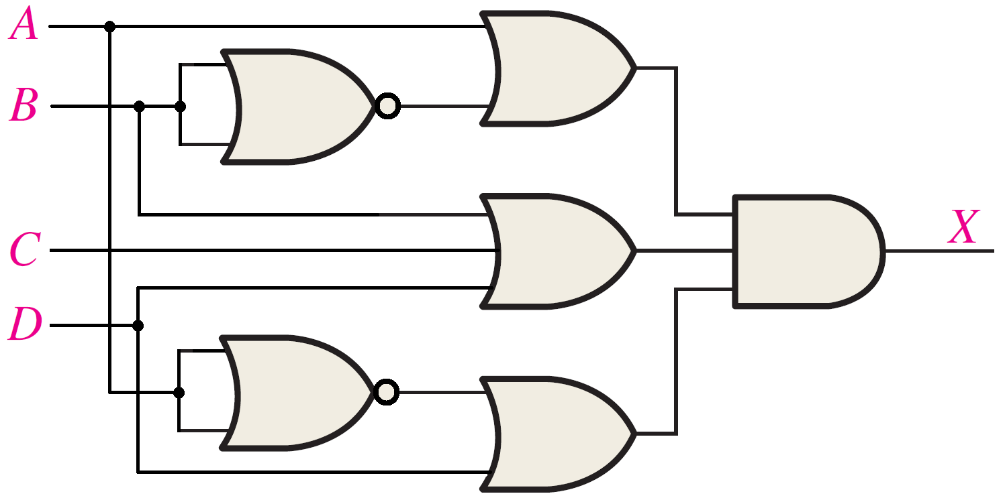


Implementing POS expressions using NOR Logic
Example: POS ➔ AND-OR logic
$$X=(A+\overline{B})(B+C+D)(\overline{A}+D)$$
$$A+\overline{B}$$
Start from the AND-OR implementation (like slide #8) and then replace each:
Inverter ➔ NOR gate (Connected inputs).
OR ➔ NOR
AND ➔ NOR
$$\overline{B}$$
$$B+C+D$$
$$\overline{A}$$
$$\overline{A}+D$$

Slide 12
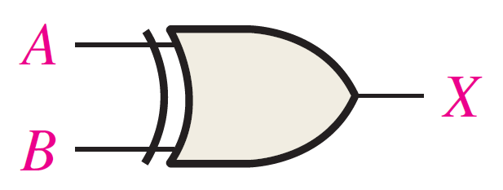
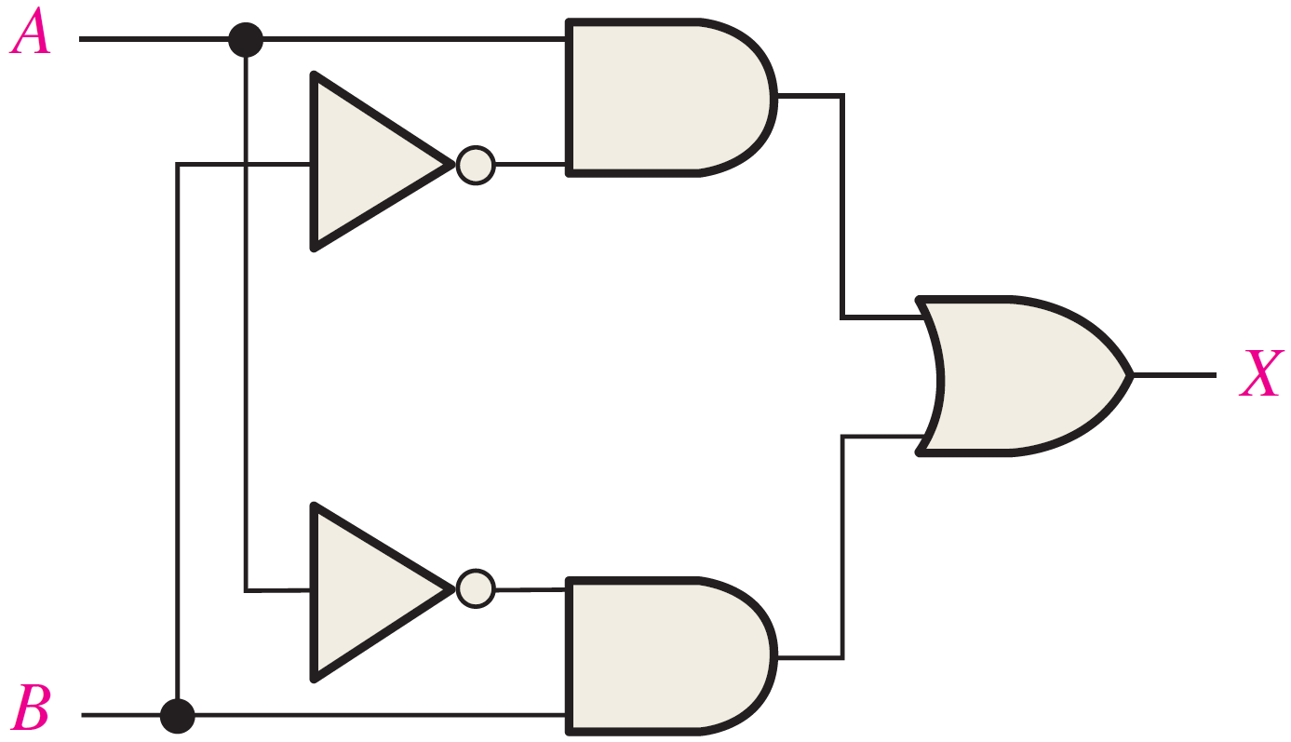
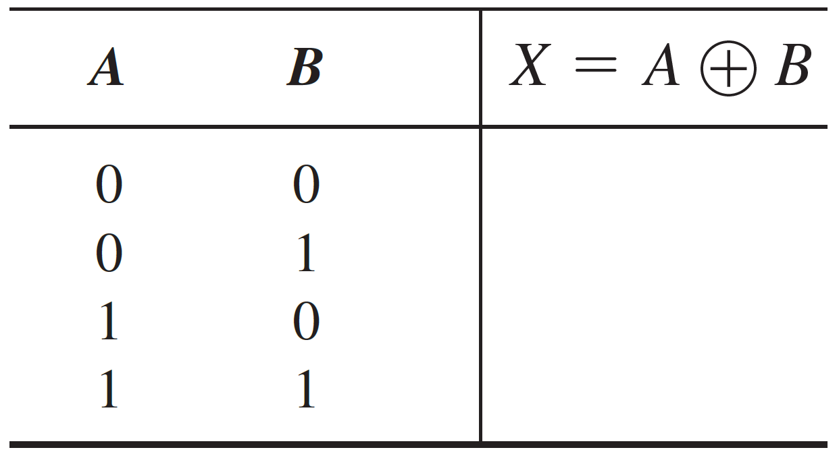
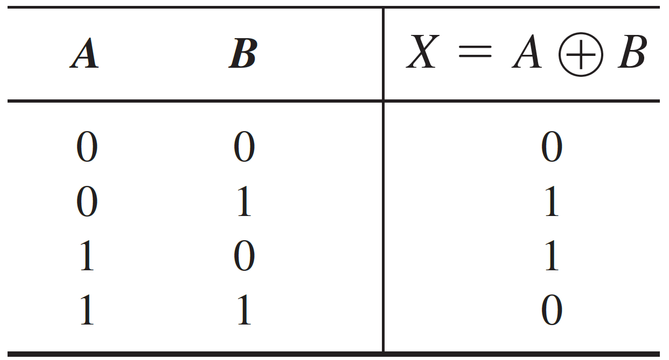
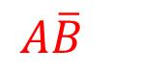
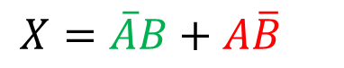

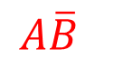


Implementing XOR Gate ($⊕$) using AND-OR Logic
1
$$A\overline{B}$$
2
4
$$\overline{A}B$$
$$A\overline{B}$$
$$\overline{A}B$$
3
$$X=\overline{A}B+A\overline{B}$$

Slide 13
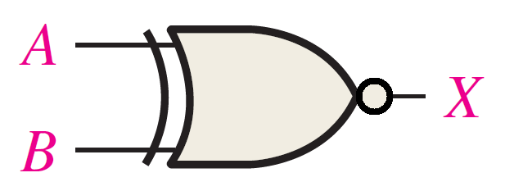
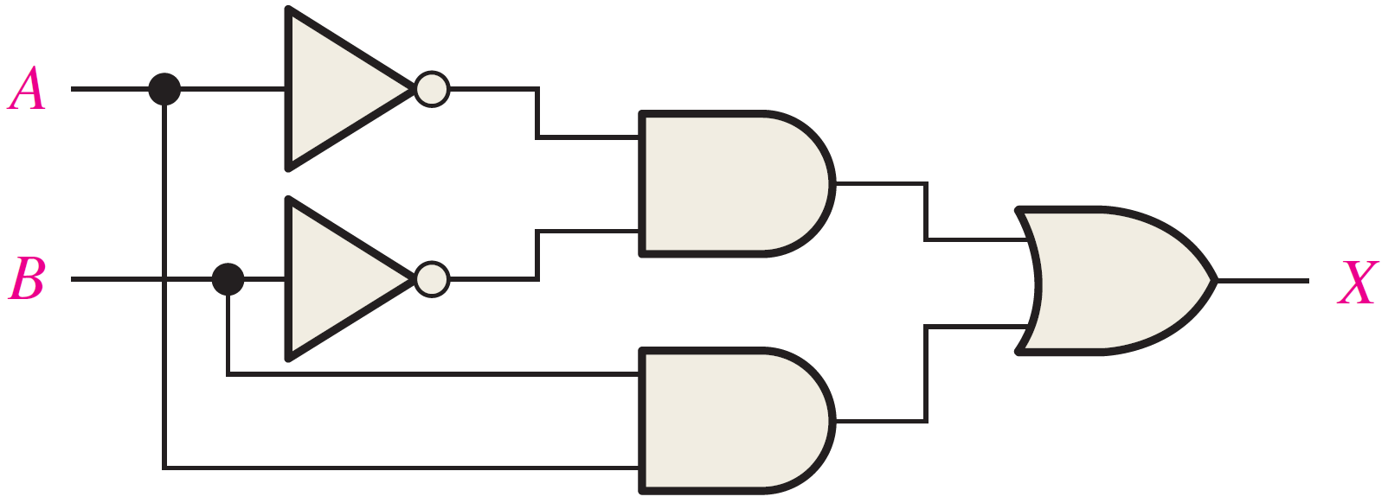

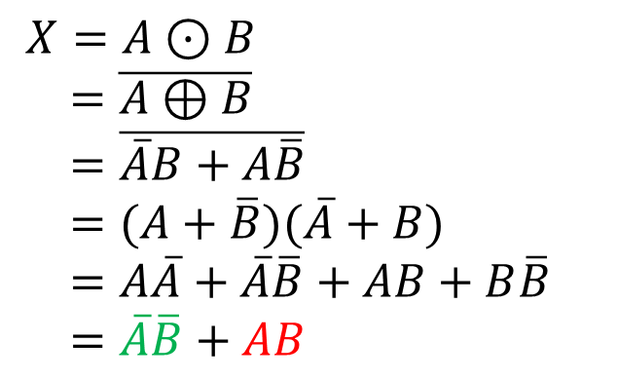

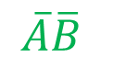
Implementing XNOR Gate ($⊙$) using AND-OR Logic
1
$$\overline{A}\overline{B}$$
$X=A⊙B$
$=\overline{A⊕B}$
$=\overline{\overline{A}B+A\overline{B}}$
$=(A+\overline{B})(\overline{A}+B)$
$=A\overline{A}+\overline{A}\overline{B}+AB+B\overline{B}$
$=\overline{A}\overline{B}+AB$
3
2
$$AB$$

Slide 14
Chapter 6: Functions of Combinational Logic

Slide 15
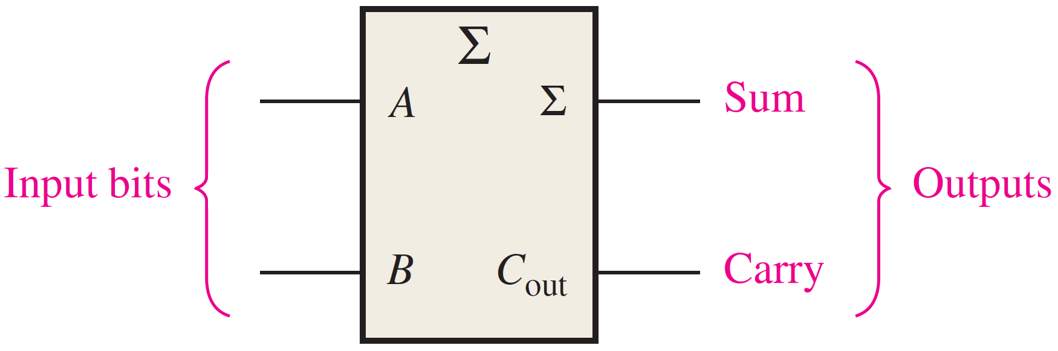
The Half-Adder
A combinational logic circuit.
Purpose: adds two bits, by rules of binary addition:
Input/Output:
Accepts two binary digits
Produces a sum bit and a carry bit.
 | 0 |  |  |  | 0 |  |  |  | 1 |  |  |  | 1
+ | 0 |  |  | + | 1 |  |  | + | 0 |  |  | + | 1
 | 0 |  |  |  | 1 |  |  |  | 1 |  |  |  | 10

Slide 16
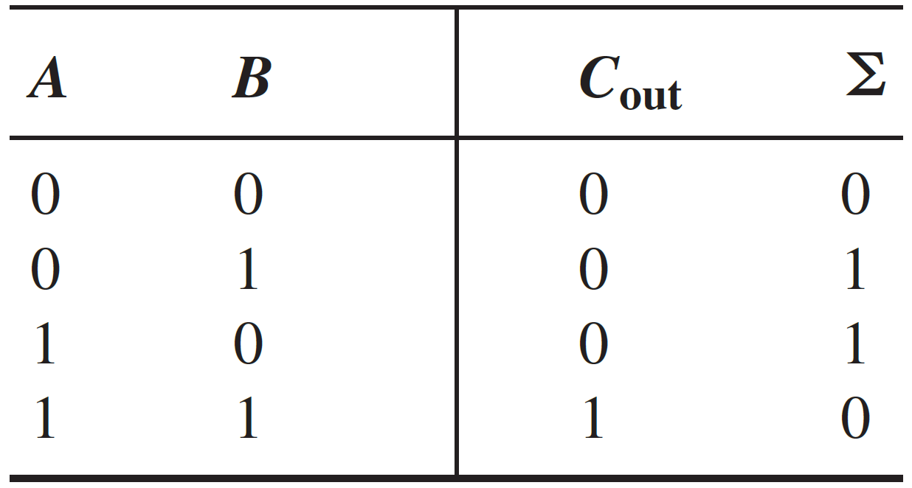
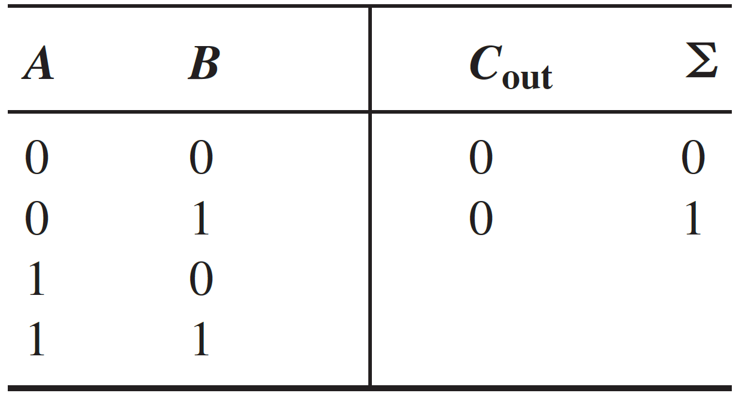
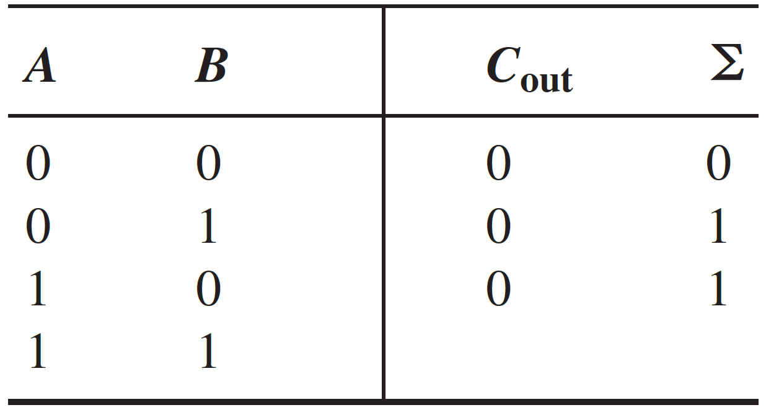
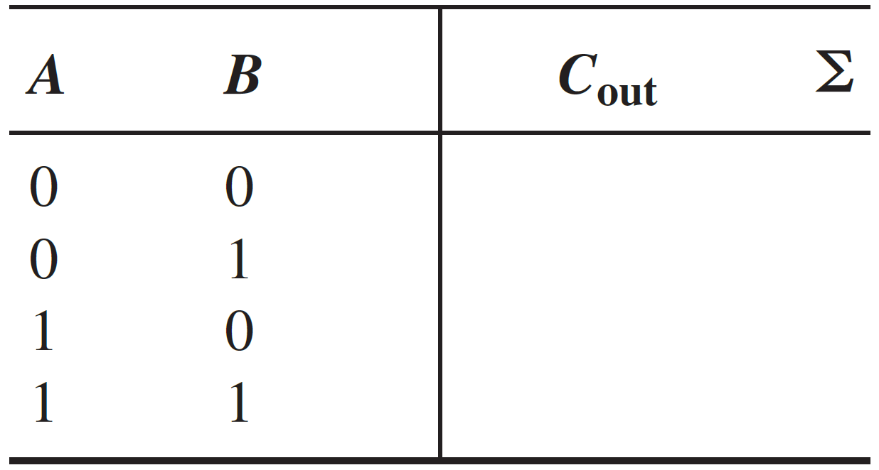
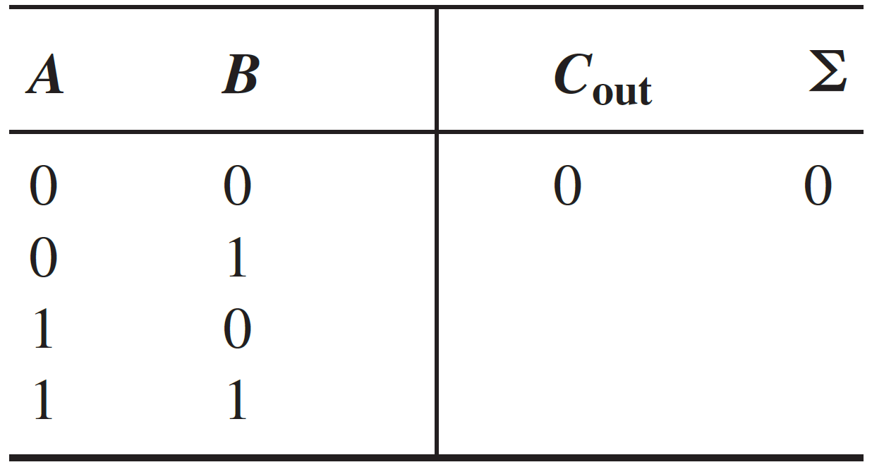
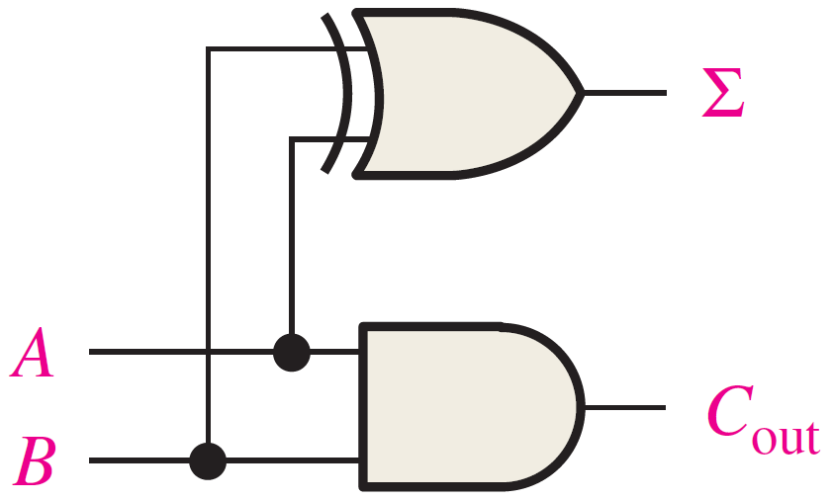
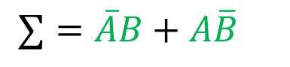
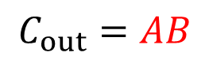

Implementing the Half Adder
$$C_{out}=AB$$
1
3
$$∑=\overline{A}B+A\overline{B}$$
$$=A⊕B$$
2
4

Slide 17

The Full-Adder
A combinational logic circuit.
Purpose: adds three bits
Input/Output:
Accepts two binary digits & input carry
Produces a sum bit and a carry bit.

Slide 18











Implementing the Full Adder
1
$C_{out}=\overline{A}BC_{in}+A\overline{B}C_{in}+AB{\overline{C}}_{in}+ABC_{in}$
$=(\overline{A}B+A\overline{B})C_{in}+AB({\overline{C}}_{in}+C_{in})$
$=(A⊕B)$ $C_{in}+AB$
3
$∑=\overline{A}\overline{B}C_{in}+\overline{A}B{\overline{C}}_{in}+A\overline{B}{\overline{C}}_{in}+ABC_{in}$
$=(\overline{A}\overline{B}+AB)C_{in}+(\overline{A}B+A\overline{B}){\overline{C}}_{in}$
$=(A⊙B)C_{in}+(A⊕B){\overline{C}}_{in}$
$=(\overline{A⊕B})C_{in}+(A⊕B){\overline{C}}_{in}$
$=(A⊕B)⊕C_{in}$
2

Slide 19





Implementing the Full Adder
$∑=(A⊕B)⊕C_{in}$
3
4
$C_{out}=(A⊕B)$ $C_{in}+AB$

Slide 20


Implementing the Full Adder
4

Slide 21
Reading Material
Floyd, Chapter 5:
Pages 234 – 235, 237, 239 – 248, 250, 252 – 255
Floyd, Chapter 6:
Pages 285 - 289

